Slide 1
Econ 642: Week 8
Monetary Topics: Money Supply, Money Demand, and Inflation
Kurlat Chapter 10 & 11

Slide 2
Announcements
Discussion 8 is available
Problem Set 3
Due Friday 1/24/2025
Presentation Group 3
Presenting on 1/28/2025
Send you slides by 1/25/2025
Presentation 4 is on 2/11/2025
Send your slides by 2/8/2025

Slide 3
Overview
Money Supply
What is Money
Changing Money Supply
Money Demand
Price Levels and Inflation
Measurement of Prices
Equilibrium
Seignorage
Cost of Inflation

Slide 4
Money Supply and Demand
Kurlat Chapter 10

Slide 5
What is Money?
Up until now we have worked with real terms or in units of goods
We’ll now cover monetary topics and nominal terms
What is money?
This is a bit trickier than you first think about it
Our standard answer is
A store of value: you can save it and use it later
A unit of account: you can express prices of goods and services with it
A medium of exchange: money changes hands when people pay for goods
Money has taken different forms throughout history
Paper, coins, gold, silver, cigarettes, etc. What about crypto?

Slide 6
What is Money?
Why do we need money? Why don’t we just barter?
Money solves the issue of “double coincidence of wants”
With money I don’t need to track down people who have exactly what I want and they want exactly what I have
We can exchange goods and services with money to solve this double coincidence of wants
Search costs matter

Slide 7
What is Money?
Money also needs to be convenient and have the properties of:
It has to be hard to counterfeit – the seller has to trust it is not counterfeit
It has to be easy to carry
It has to be durable – It is not a good store of value otherwise (for example, coffee beans are more durable than strawberries with rot).
It has to be easily divisible – it should be easy to pay exact price
It has to be commonly accepted – everyone agree that it is money through social agreement or through laws

Slide 8
What is Money?
We’ll look at different scopes of money from narrower to broader
M0 counts money as only physical currency and it meets the conditions of money well, but not perfectly since it can be counterfeited
M1 includes demand deposits (checking accounts) and it is convenient with paying with a check or credit card
Monetary Base | M0 | M1 | M2
Physical Currency | Physical Currency | Physical Current | Physical Currency
Central Bank Reserves |  | Demand Deposits | Demand Deposits
 |  |  | Savings Deposits
 |  |  | Small Time Deposits
 |  |  | Money Market Mutual Funds

Slide 9
What is Money?
We’ll look at different scopes of money from narrower to broader
M2 includes M1 plus savings accounts and smaller deposits and money market mutual funds
The monetary base has this name since it is directly controlled by the government – we’ll cover this a bit more later
Monetary Base | M0 | M1 | M2
Physical Currency | Physical Currency | Physical Current | Physical Currency
Central Bank Reserves |  | Demand Deposits | Demand Deposits
 |  |  | Savings Deposits
 |  |  | Small Time Deposits
 |  |  | Money Market Mutual Funds

Slide 10
Money Supply

Slide 11
Money Supply
The money supply is chosen in part by the government (the Federal Reserve in the US)
This partially impacts the assets and liabilities of banks
The central bank controls the monetary base and can impact the M1 supply of money through the M1 money multiplier
How does it fit together?
We’ll look at a bank balance sheet and see how it fits with the central bank’s role

Slide 12
Money Supply
Let’s look a bank balance sheet
We have assets and liabilities
Assets are bonds, loans, and other types of assets that earn interest
Liabilities are most deposits that customers deposit at a bank
There may be non-deposit liabilities, such as long-term bond issued by a bank
A bank’s net worth is assets minus liabilities
Balance Sheet
Assets | Liabilities
Reserves | Deposits
Bonds | Other Liabilities
Loans
Other assets

Slide 13
Money Supply
A bank earns interest through its assets, but there are also reserves
We will be focusing on these Central Bank Reserves
The Central Bank acts as a bank for banks
Reserves are the name given to deposits that banks hold at the Central Bank
This is an asset for banks and a liability for the Central Bank
Reserves typically don’t earn interest
Balance Sheet
Assets | Liabilities
Reserves | Deposits
Bonds | Other Liabilities
Loans
Other assets

Slide 14
Money Supply
If Central Bank reserves do not earn interest (or very low interest) why do bank hold these assets?
Reserves are a way to meet unexpected withdrawals of deposits
Not much of a concern today due to deposit insurance makes bank runs fairly rare
Main reason: banks keep reserves because they are required to do so from regulation
Regulation requires them to hold a minimum level of reserves
It is usually a percentage of the bank’s deposits

Slide 15
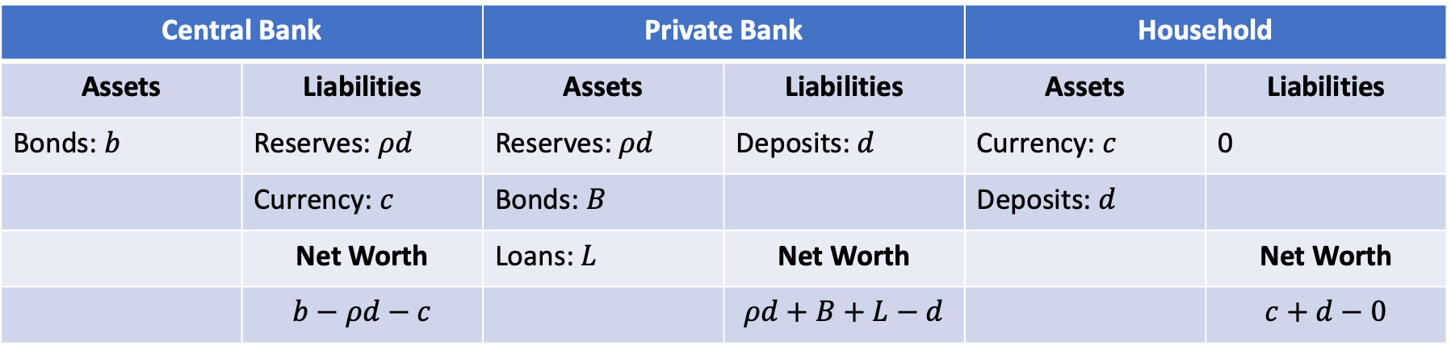
Money Supply
We have three relevant entities for computing money supply
The Central Bank
A representative commercial bank
A representative household
Central Bank |  | Private Bank |  | Household
Assets | Liabilities | Assets | Liabilities | Assets | Liabilities
Bonds: $b$ | Reserves: $ρd$ | Reserves: $ρd$ | Deposits: $d$ | Currency: $c$ | 0
 | Currency: $c$ | Bonds: $B$ |  | Deposits: $d$
 | Net Worth | Loans: $L$ | Net Worth |  | Net Worth
 | $$b−ρd−c$$ |  | $$ρd+B+L−d$$ |  | $$c+d−0$$

Slide 16
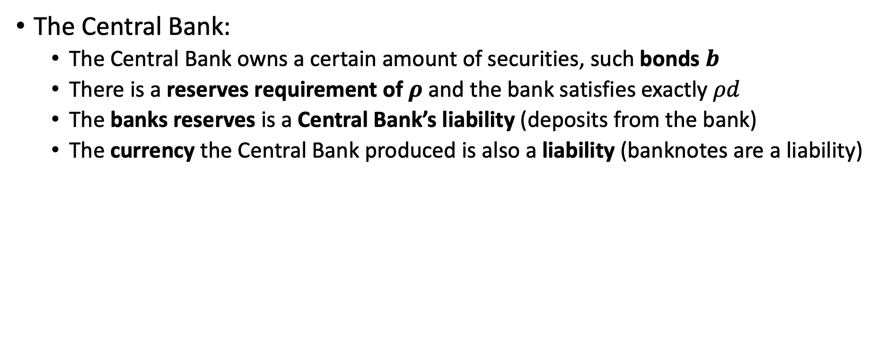
Money Supply
The Central Bank:
The Central Bank owns a certain amount of securities, such bonds $b$
There is a reserves requirement of $ρ$ and the bank satisfies exactly $ρd$
The banks reserves is a Central Bank’s liability (deposits from the bank)
The currency the Central Bank produced is also a liability (banknotes are a liability)
Central Bank |  | Private Bank |  | Household
Assets | Liabilities | Assets | Liabilities | Assets | Liabilities
Bonds: $b$ | Reserves: $ρd$ | Reserves: $ρd$ | Deposits: $d$ | Currency: $c$ | 0
 | Currency: $c$ | Bonds: $B$ |  | Deposits: $d$
 | Net Worth | Loans: $L$ | Net Worth |  | Net Worth
 | $$b−ρd−c$$ |  | $$ρd+B+L−d$$ |  | $$c+d−0$$

Slide 17
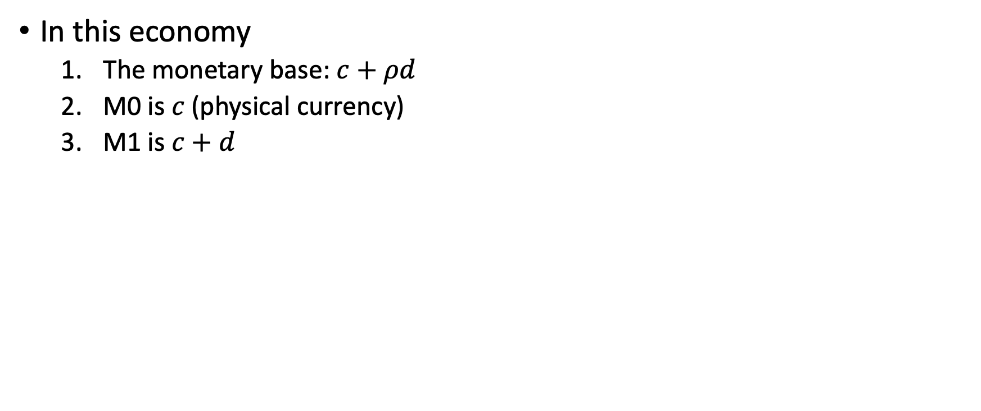
Money Supply
In this economy
The monetary base: $c+ρd$
M0 is $c$ (physical currency)
M1 is $c+d$
Central Bank |  | Private Bank |  | Household
Assets | Liabilities | Assets | Liabilities | Assets | Liabilities
Bonds: $b$ | Reserves: $ρd$ | Reserves: $ρd$ | Deposits: $d$ | Currency: $c$ | 0
 | Currency: $c$ | Bonds: $B$ |  | Deposits: $d$
 | Net Worth | Loans: $L$ | Net Worth |  | Net Worth
 | $$b−ρd−c$$ |  | $$ρd+B+L−d$$ |  | $$c+d−0$$

Slide 18
Changing the Supply of Money: M1 Multiplier
Through the M1 money multiplier the Central Base can indirectly control money M1
The Central Bank only directly controls the monetary base
But, the Central Bank change the supply of money through the M1 Multiplier
We’ll look at the traditional way

Slide 19
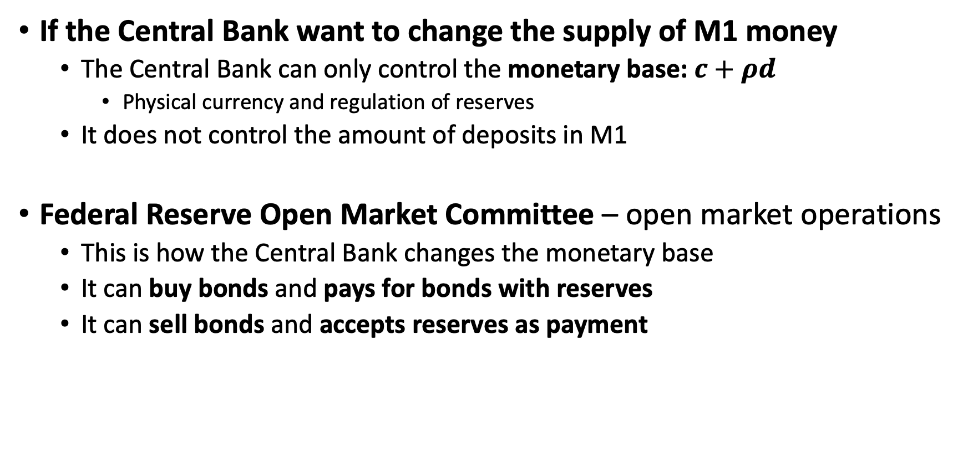
Changing the Supply of Money: M1 Multiplier
If the Central Bank want to change the supply of M1 money
The Central Bank can only control the monetary base: $c+ρd$
Physical currency and regulation of reserves
It does not control the amount of deposits in M1
Federal Reserve Open Market Committee – open market operations
This is how the Central Bank changes the monetary base
It can buy bonds and pays for bonds with reserves
It can sell bonds and accepts reserves as payment

Slide 20
Changing the Supply of Money
Increase the monetary base: Buy securities
The Federal Reserve buys securities, such as bonds, from any party and pays with a check
That check, written by the Federal Reserve, is deposited by a bank into its account that it has at the Federal Reserve
This increases the reserves and increases the monetary base
Decrease the monetary base: Sell securities
If it wants to reduce the monetary base, it sells securities
When it sells a security, the bank reduces it’s reserves at the Federal Reserve
https://www.stlouisfed.org/on-the-economy/2018/july/federal-reserve-control-supply-money

Slide 21
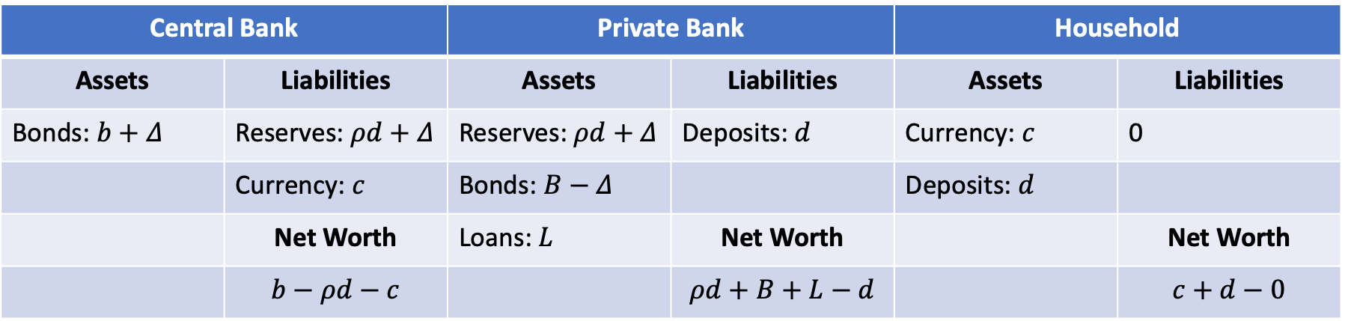
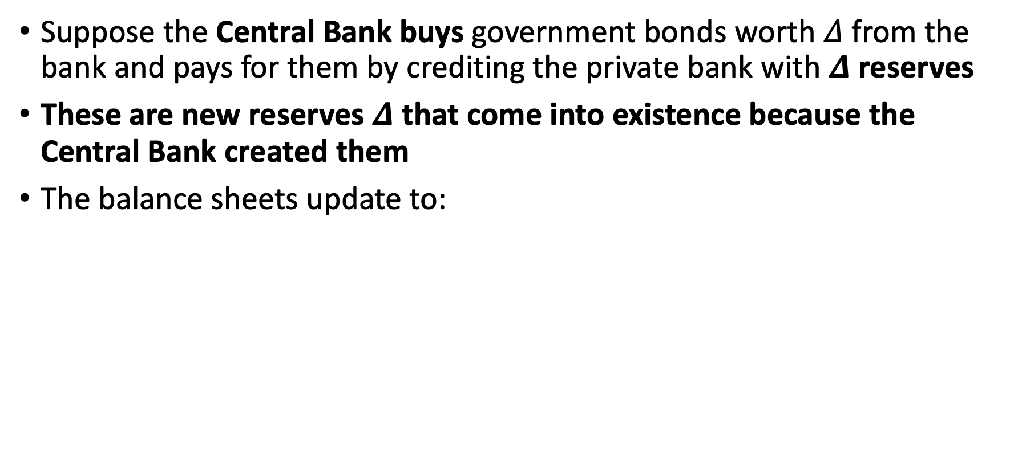
Changing the Supply of Money
Suppose the Central Bank buys government bonds worth $Δ$ from the bank and pays for them by crediting the private bank with $Δ$ reserves
These are new reserves $Δ$ that come into existence because the Central Bank created them
The balance sheets update to:
Central Bank |  | Private Bank |  | Household
Assets | Liabilities | Assets | Liabilities | Assets | Liabilities
Bonds: $b+Δ$ | Reserves: $ρd+Δ$ | Reserves: $ρd+Δ$ | Deposits: $d$ | Currency: $c$ | 0
 | Currency: $c$ | Bonds: $B−Δ$ |  | Deposits: $d$
 | Net Worth | Loans: $L$ | Net Worth |  | Net Worth
 | $$b−ρd−c$$ |  | $$ρd+B+L−d$$ |  | $$c+d−0$$

Slide 22

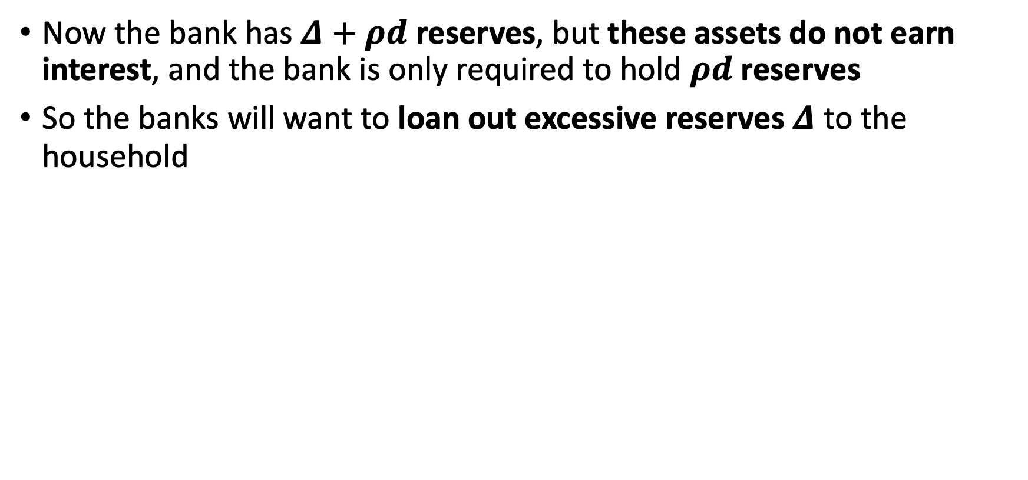
Changing the Supply of Money
Now the bank has $Δ+ρd$ reserves, but these assets do not earn interest, and the bank is only required to hold $ρd$ reserves
So the banks will want to loan out excessive reserves $Δ$ to the household
Central Bank |  | Private Bank |  | Household
Assets | Liabilities | Assets | Liabilities | Assets | Liabilities
Bonds: $b+Δ$ | Reserves: $ρd+Δ$ | Reserves: $ρd+Δ$ | Deposits: $d$ | Currency: $c$ | 0
 | Currency: $c$ | Bonds: $B−Δ$ |  | Deposits: $d$
 | Net Worth | Loans: $L$ | Net Worth |  | Net Worth
 | $$b−ρd−c$$ |  | $$ρd+B+L−d$$ |  | $$c+d−0$$

Slide 23
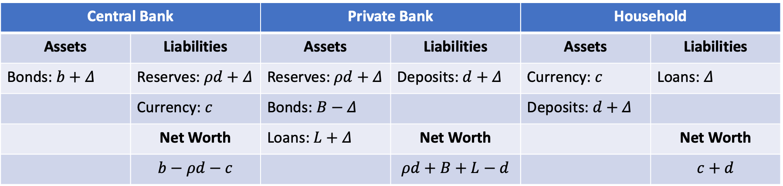
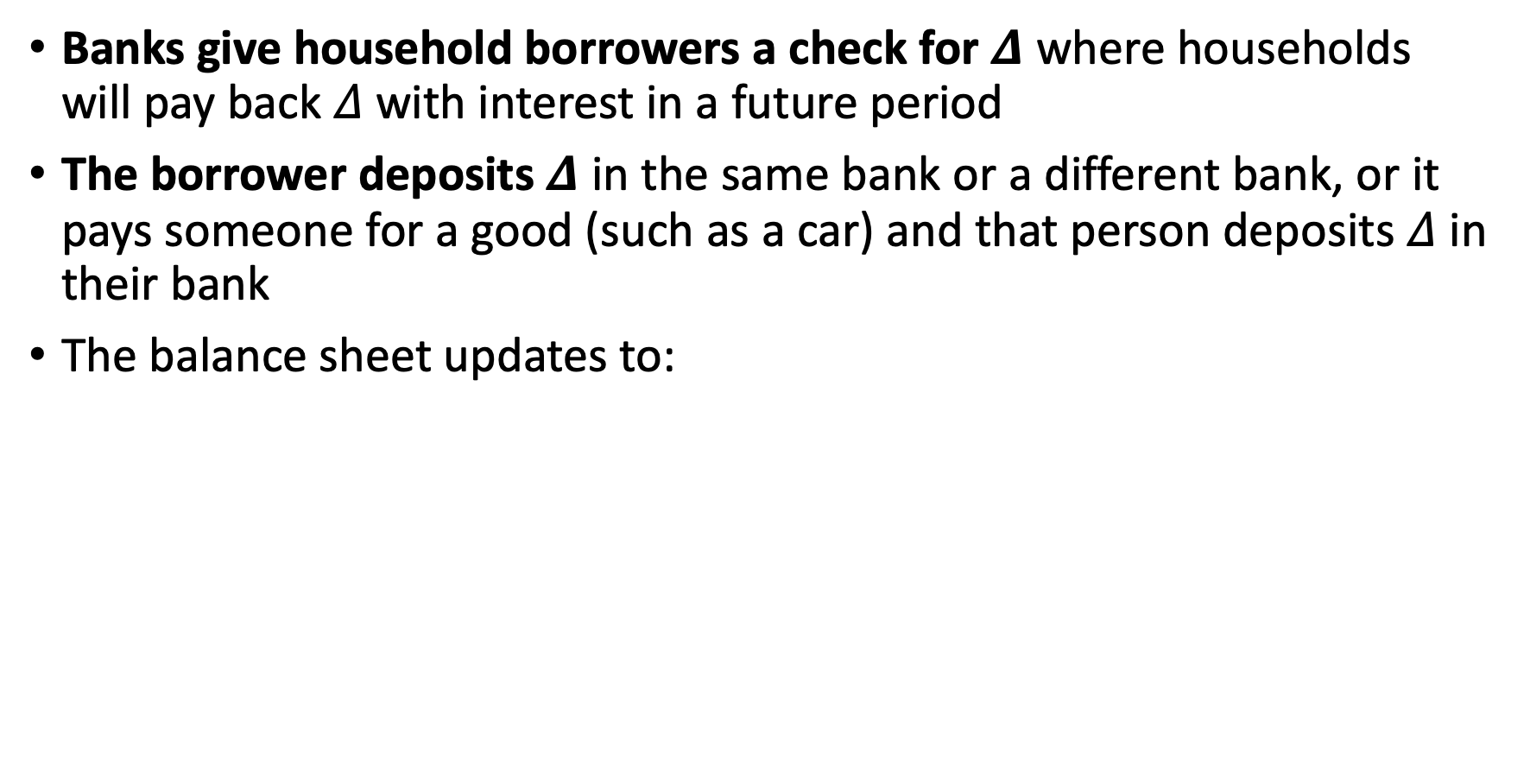
Changing the Supply of Money
Banks give household borrowers a check for $Δ$ where households will pay back $Δ$with interest in a future period
The borrower deposits $Δ$ in the same bank or a different bank, or it pays someone for a good (such as a car) and that person deposits $Δ$ in their bank
The balance sheet updates to:
Central Bank |  | Private Bank |  | Household
Assets | Liabilities | Assets | Liabilities | Assets | Liabilities
Bonds: $b+Δ$ | Reserves: $ρd+Δ$ | Reserves: $ρd+Δ$ | Deposits: $d+Δ$ | Currency: $c$ | Loans: $Δ$
 | Currency: $c$ | Bonds: $B−Δ$ |  | Deposits: $d+Δ$
 | Net Worth | Loans: $L+Δ$ | Net Worth |  | Net Worth
 | $$b−ρd−c$$ |  | $$ρd+B+L−d$$ |  | $$c+d$$

Slide 24
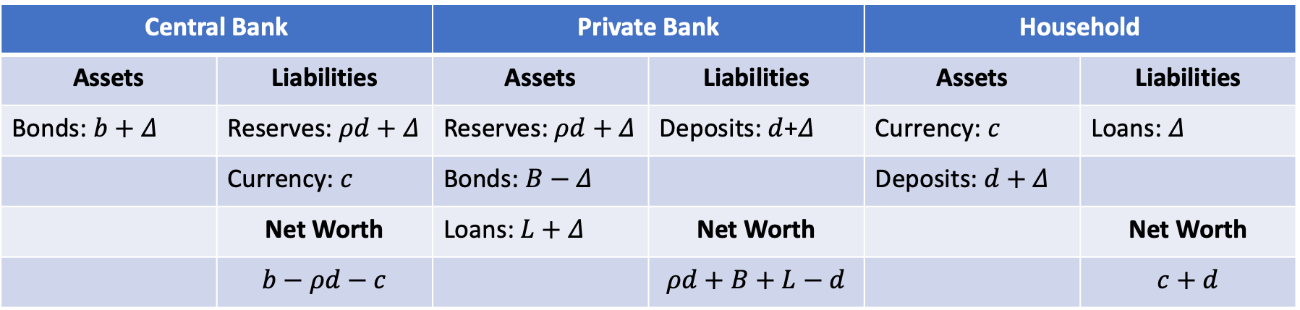
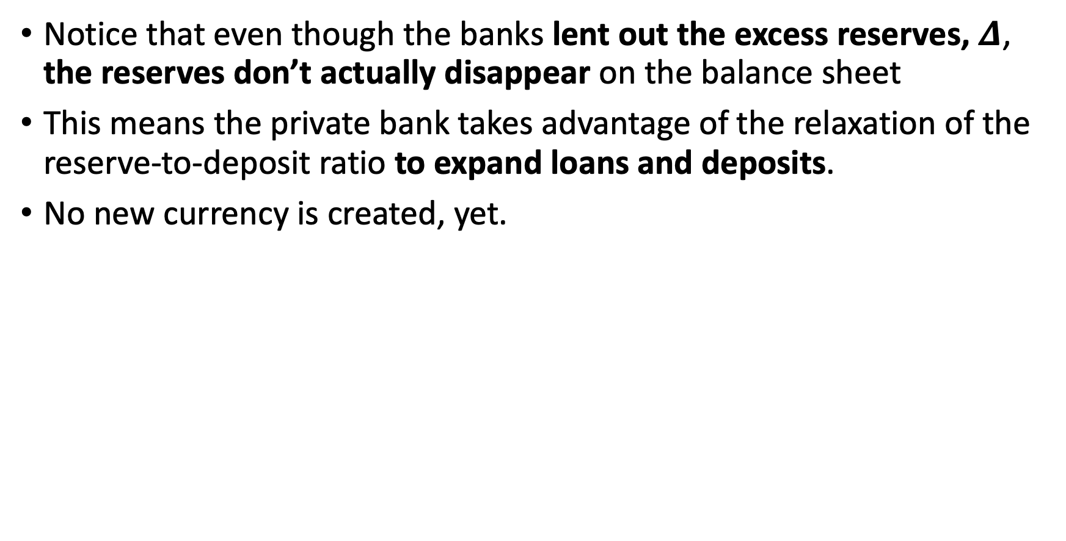
Changing the Supply of Money
Notice that even though the banks lent out the excess reserves, $Δ$, the reserves don’t actually disappear on the balance sheet
This means the private bank takes advantage of the relaxation of the reserve-to-deposit ratio to expand loans and deposits.
No new currency is created, yet.
Central Bank |  | Private Bank |  | Household
Assets | Liabilities | Assets | Liabilities | Assets | Liabilities
Bonds: $b+Δ$ | Reserves: $ρd+Δ$ | Reserves: $ρd+Δ$ | Deposits: $d$+$Δ$ | Currency: $c$ | Loans: $Δ$
 | Currency: $c$ | Bonds: $B−Δ$ |  | Deposits: $d+Δ$
 | Net Worth | Loans: $L+Δ$ | Net Worth |  | Net Worth
 | $$b−ρd−c$$ |  | $$ρd+B+L−d$$ |  | $$c+d$$

Slide 25
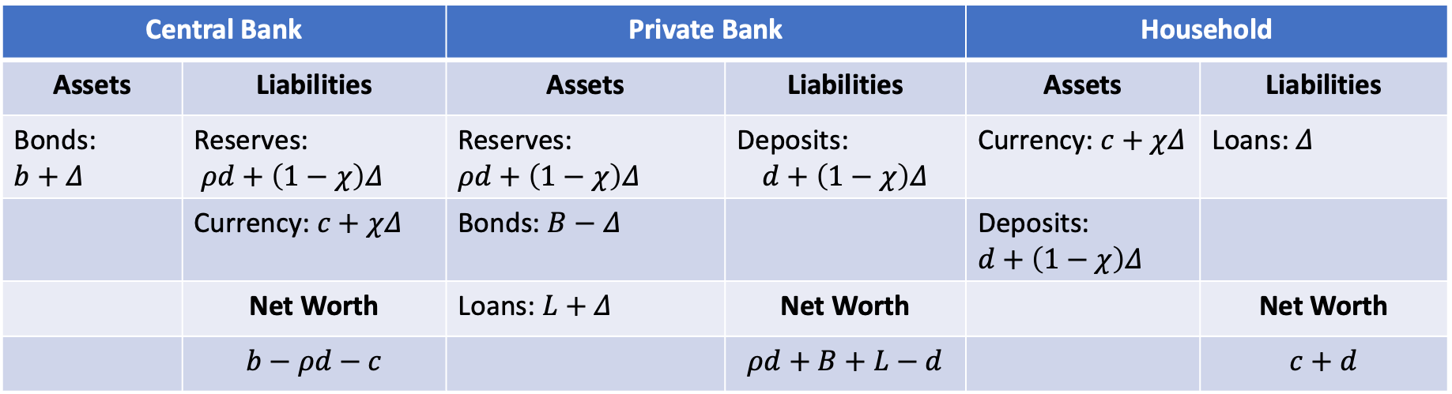
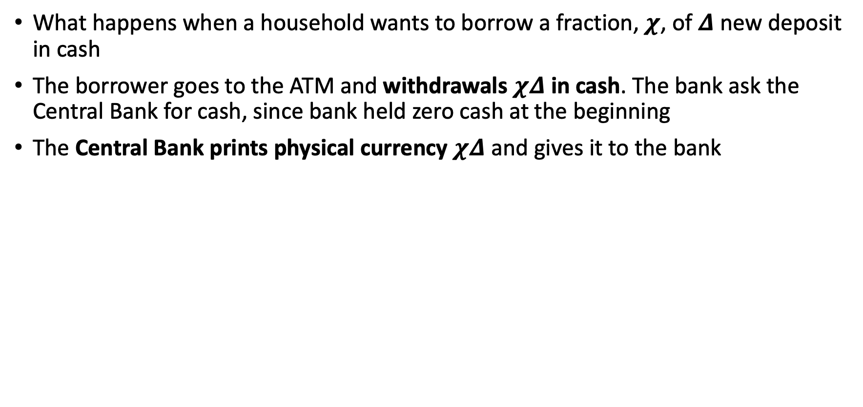
Changing the Supply of Money
What happens when a household wants to borrow a fraction, $χ$, of $Δ$ new deposit in cash
The borrower goes to the ATM and withdrawals $χΔ$ in cash. The bank ask the Central Bank for cash, since bank held zero cash at the beginning
The Central Bank prints physical currency $χΔ$ and gives it to the bank
Central Bank |  | Private Bank |  | Household
Assets | Liabilities | Assets | Liabilities | Assets | Liabilities
Bonds: $$b+Δ$$ | Reserves: $ρd+\left(1−χ\right)Δ$ | Reserves: $$ρd+\left(1−χ\right)Δ$$ | Deposits: $$d+\left(1−χ\right)Δ$$ | Currency: $c+χΔ$ | Loans: $Δ$
 | Currency: $c+χΔ$ | Bonds: $B−Δ$ |  | Deposits: $$d+\left(1−χ\right)Δ$$
 | Net Worth | Loans: $L+Δ$ | Net Worth |  | Net Worth
 | $$b−ρd−c$$ |  | $$ρd+B+L−d$$ |  | $$c+d$$

Slide 26
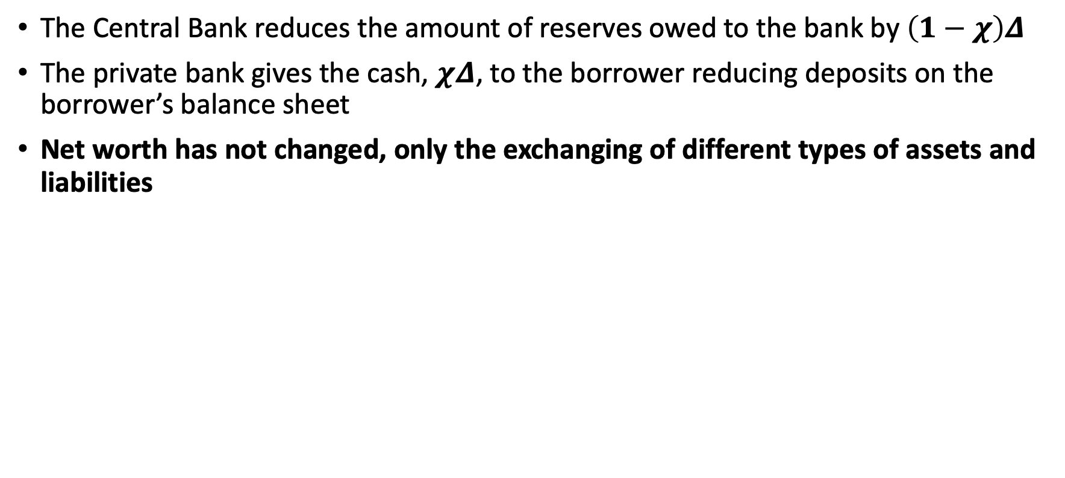
Changing the Supply of Money
The Central Bank reduces the amount of reserves owed to the bank by $\left(1−χ\right)Δ$
The private bank gives the cash, $χΔ$, to the borrower reducing deposits on the borrower’s balance sheet
Net worth has not changed, only the exchanging of different types of assets and liabilities
Central Bank |  | Private Bank |  | Household
Assets | Liabilities | Assets | Liabilities | Assets | Liabilities
Bonds: $$b+Δ$$ | Reserves: $ρd+\left(1−χ\right)Δ$ | Reserves: $$ρd+\left(1−χ\right)Δ$$ | Deposits: $$d+\left(1−χ\right)Δ$$ | Currency: $c+χΔ$ | Loans: $Δ$
 | Currency: $c+χΔ$ | Bonds: $B−Δ$ |  | Deposits: $$d+\left(1−χ\right)Δ$$
 | Net Worth | Loans: $L+Δ$ | Net Worth |  | Net Worth
 | $$b−ρd−c$$ |  | $$ρd+B+L−d$$ |  | $$c+d$$

Slide 27
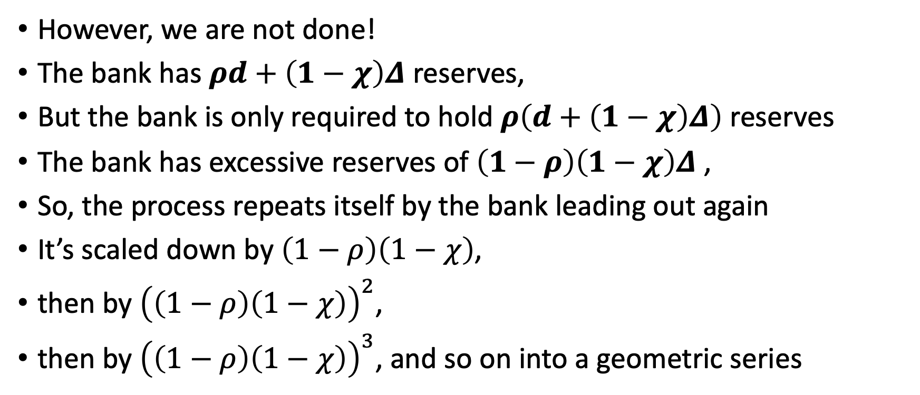
Changing the Money Supply
However, we are not done!
The bank has $ρd+\left(1−χ\right)Δ$ reserves,
But the bank is only required to hold $ρ\left(d+\left(1−χ\right)Δ\right)$ reserves
The bank has excessive reserves of $\left(1−ρ\right)\left(1−χ\right)Δ$ ,
So, the process repeats itself by the bank leading out again
It’s scaled down by $\left(1−ρ\right)\left(1−χ\right)$,
then by ${\left(\left(1−ρ\right)\left(1−χ\right)\right)}^{2}$,
then by ${\left(\left(1−ρ\right)\left(1−χ\right)\right)}^{3}$, and so on into a geometric series

Slide 28
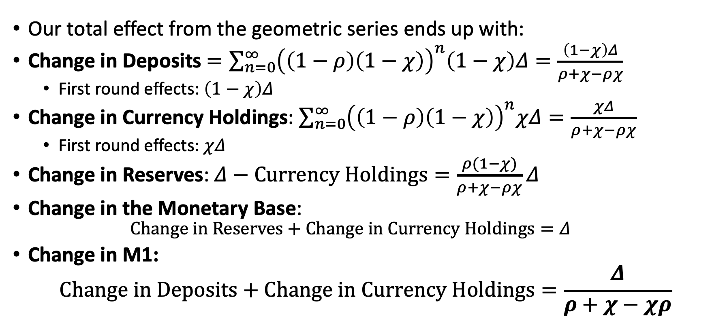
Changing the Money Supply
Our total effect from the geometric series ends up with:
Change in Deposits $=\sum_{n=0}^{∞}{{\left(\left(1−ρ\right)\left(1−χ\right)\right)}^{n}\left(1−χ\right)Δ=\frac{\left(1−χ\right)Δ}{ρ+χ−ρχ}}$
First round effects: $\left(1−χ\right)Δ$
Change in Currency Holdings: $\sum_{n=0}^{∞}{{\left(\left(1−ρ\right)\left(1−χ\right)\right)}^{n}χΔ=\frac{χΔ}{ρ+χ−ρχ}}$
First round effects: $χΔ$
Change in Reserves: $Δ−Currency Holdings=\frac{ρ(1−χ)}{ρ+χ−ρχ}Δ$
Change in the Monetary Base:
$$Change in Reserves+Change in Currency Holdings=Δ$$
Change in M1:
$$Change in Deposits+Change in Currency Holdings=\frac{Δ}{ρ+χ−χρ}$$

Slide 29
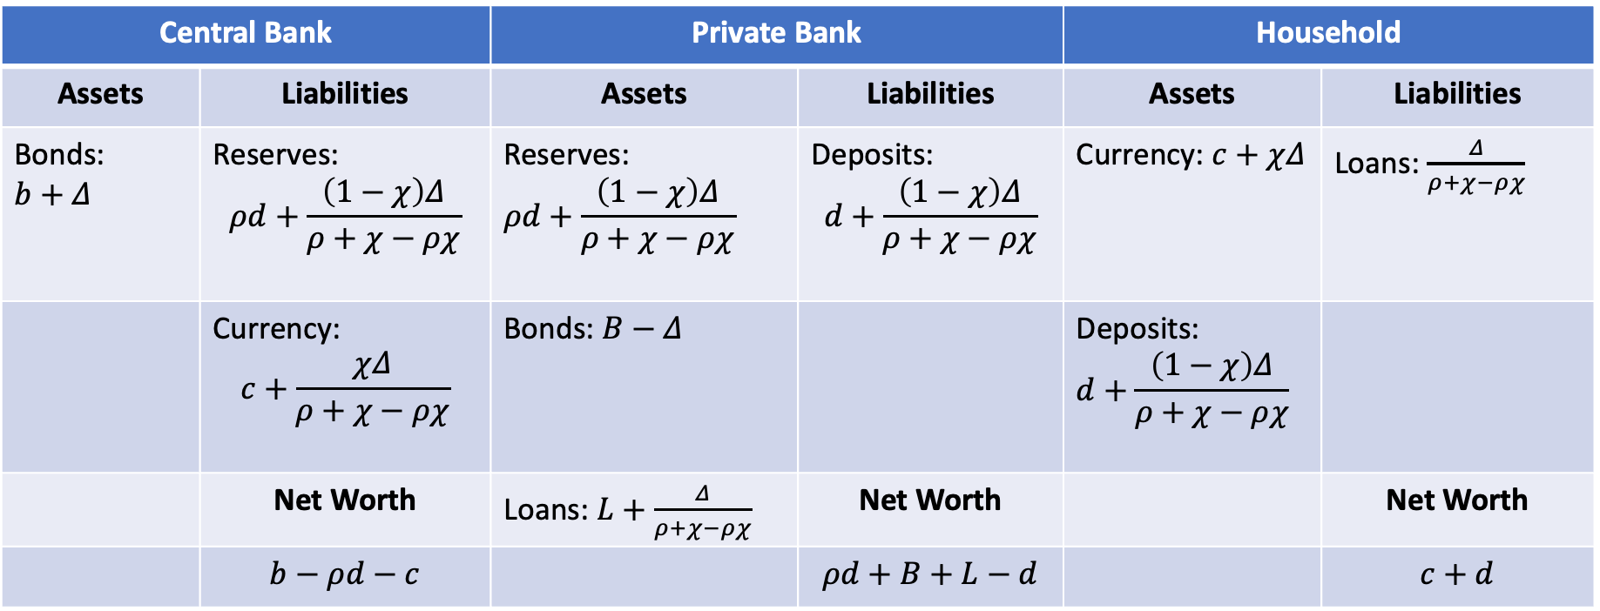
Changing the Supply of Money
The final balance sheet ends up being and bank are meeting the reserve requirement exactly
Central Bank |  | Private Bank |  | Household
Assets | Liabilities | Assets | Liabilities | Assets | Liabilities
Bonds: $$b+Δ$$ | Reserves: $$ρd+\frac{\left(1−χ\right)Δ}{ρ+χ−ρχ}$$ | Reserves: $$ρd+\frac{\left(1−χ\right)Δ}{ρ+χ−ρχ}$$ | Deposits: $$d+\frac{\left(1−χ\right)Δ}{ρ+χ−ρχ}$$ | Currency: $c+χΔ$ | Loans: $\frac{Δ}{ρ+χ−ρχ}$
 | Currency: $$c+\frac{χΔ}{ρ+χ−ρχ}$$ | Bonds: $B−Δ$ |  | Deposits: $$d+\frac{\left(1−χ\right)Δ}{ρ+χ−ρχ}$$
 | Net Worth | Loans: $L+\frac{Δ}{ρ+χ−ρχ}$ | Net Worth |  | Net Worth
 | $$b−ρd−c$$ |  | $$ρd+B+L−d$$ |  | $$c+d$$

Slide 30
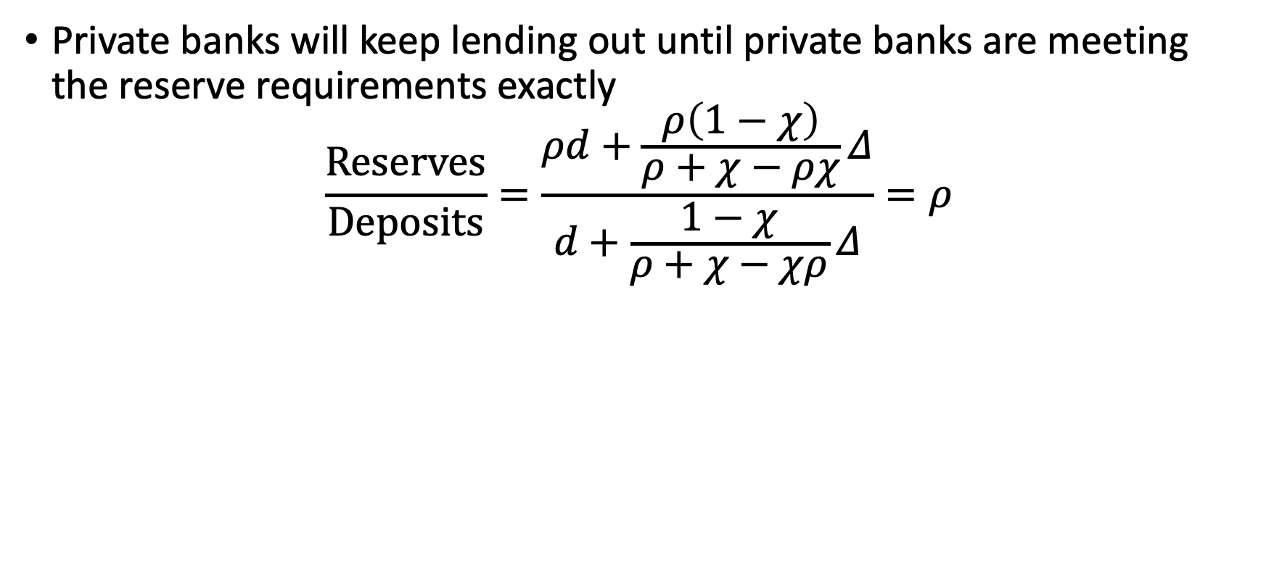
Changing of Money Supply
Private banks will keep lending out until private banks are meeting the reserve requirements exactly
$$\frac{Reserves}{Deposits}=\frac{ρd+\frac{ρ\left(1−χ\right)}{ρ+χ−ρχ}Δ}{d+\frac{1−χ}{ρ+χ−χρ}Δ}=ρ$$

Slide 31
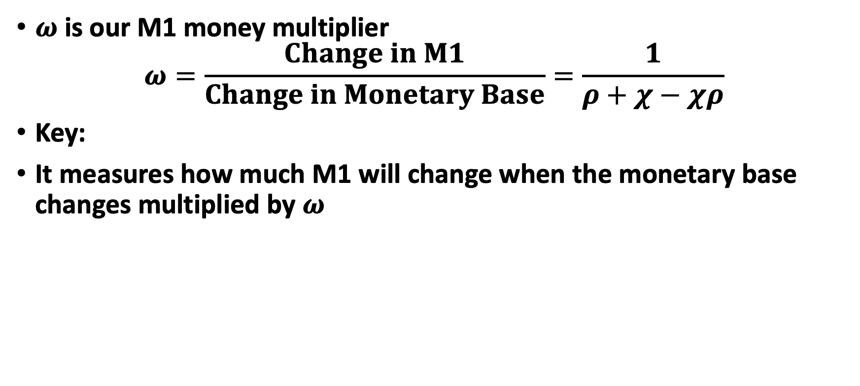
Changing of Money Supply
$ω$ is our M1 money multiplier
$$ω=\frac{Change in M1}{Change in Monetary Base}=\frac{1}{ρ+χ−χρ}$$
Key:
It measures how much M1 will change when the monetary base changes multiplied by $ω$

Slide 32
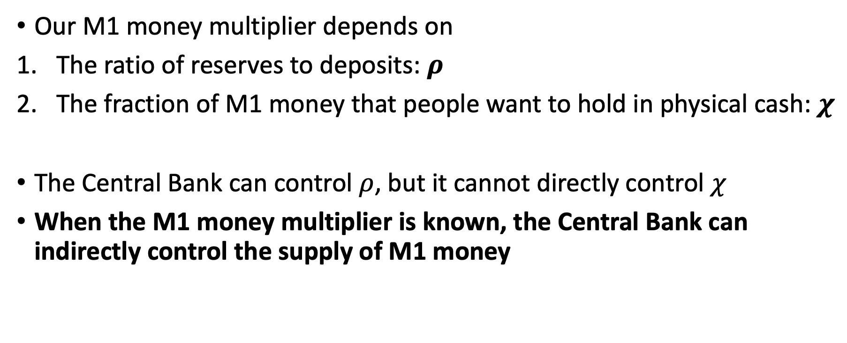
Changing the Money Supply
Our M1 money multiplier depends on
The ratio of reserves to deposits: $ρ$
The fraction of M1 money that people want to hold in physical cash: $χ$
The Central Bank can control $ρ$, but it cannot directly control $χ$
When the M1 money multiplier is known, the Central Bank can indirectly control the supply of M1 money

Slide 33
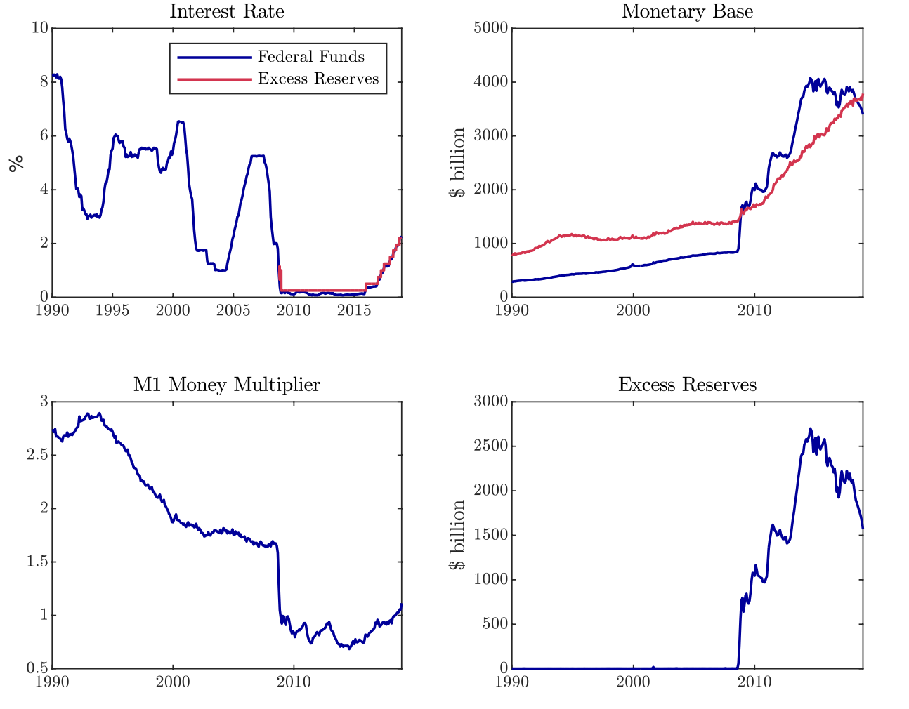
What happens when interest rate is zero?
We assumed that the Central Bank reserves pay no interest, while loans and bonds pay positive interest
What happens when the interest becomes zero?
Our model breaks down
Banks are willing to hold Central Bank reserves
This weakens the M1 money multiplier

Slide 34
Money Demand

Slide 35
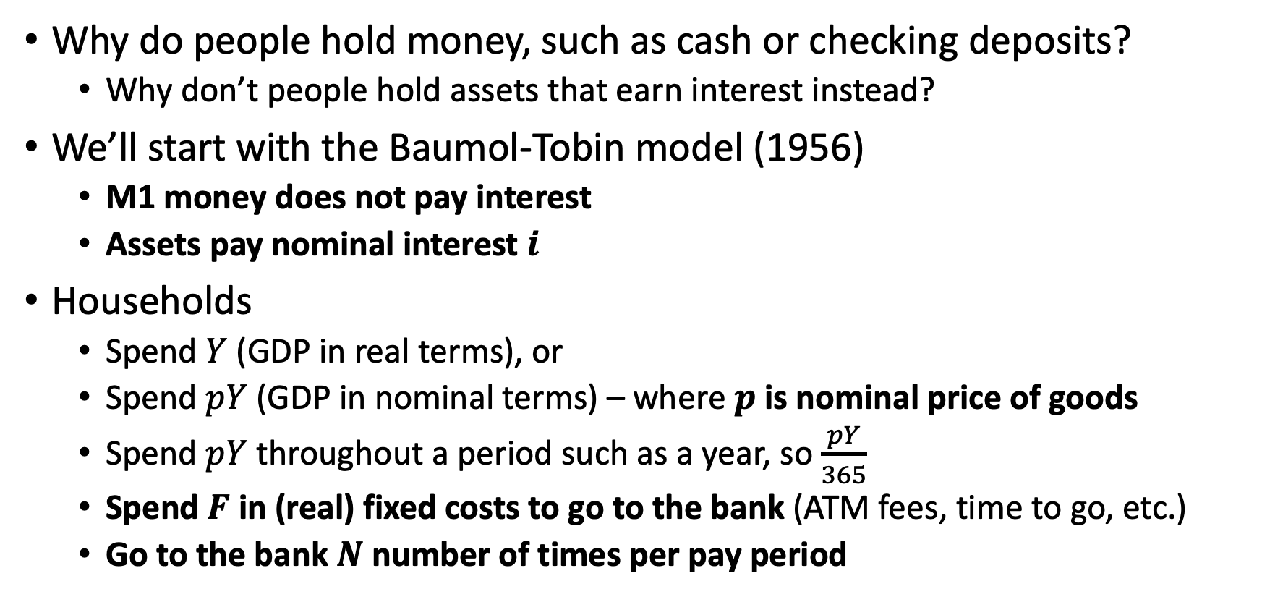
Money Demand
Why do people hold money, such as cash or checking deposits?
Why don’t people hold assets that earn interest instead?
We’ll start with the Baumol-Tobin model (1956)
M1 money does not pay interest
Assets pay nominal interest $i$
Households
Spend $Y$ (GDP in real terms), or
Spend $pY$ (GDP in nominal terms) – where $p$ is nominal price of goods
Spend $pY$ throughout a period such as a year, so $\frac{pY}{365}$
Spend $F$ in (real) fixed costs to go to the bank (ATM fees, time to go, etc.)
Go to the bank $N$ number of times per pay period

Slide 36
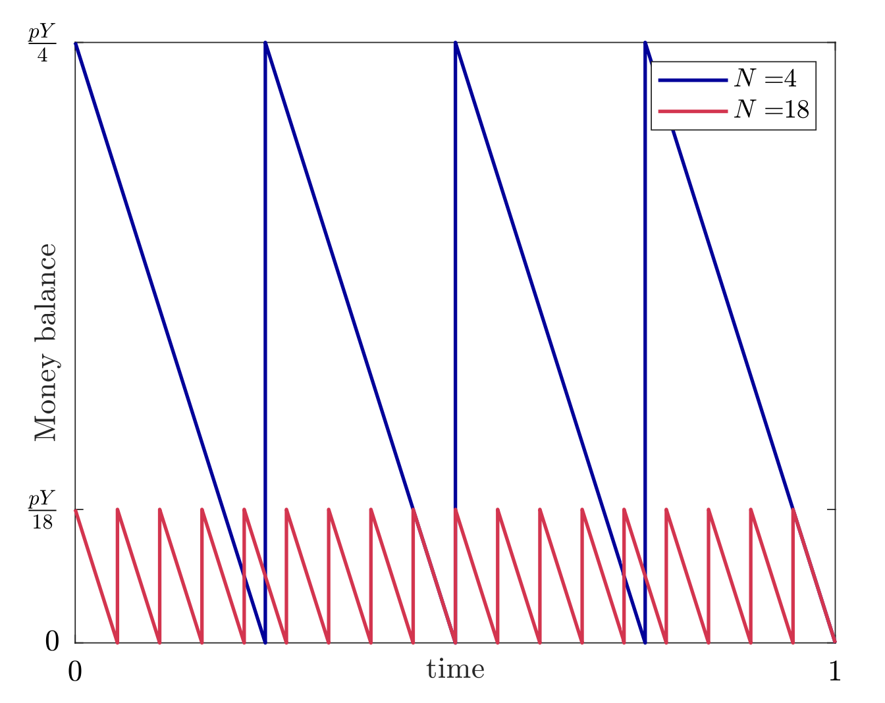
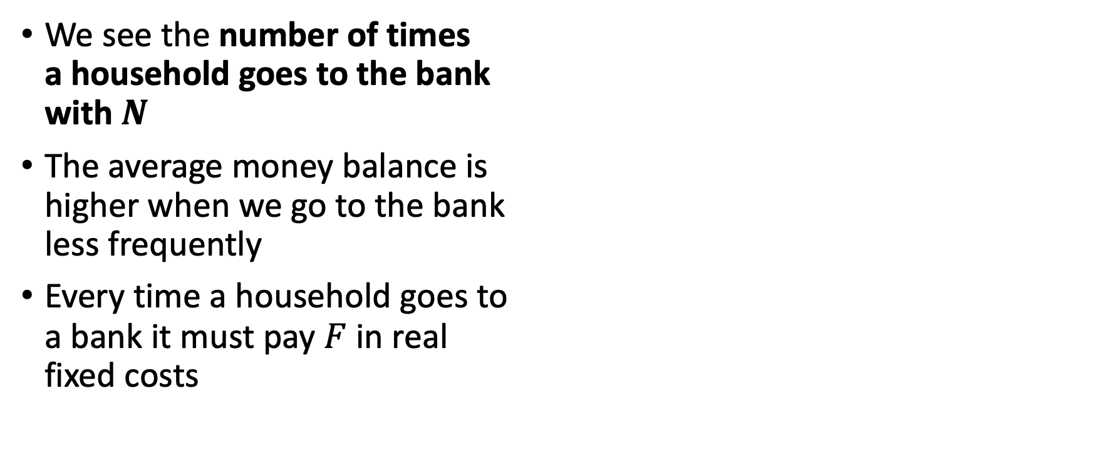
Money Demand
We see the number of times a household goes to the bank with $N$
The average money balance is higher when we go to the bank less frequently
Every time a household goes to a bank it must pay $F$ in real fixed costs

Slide 37
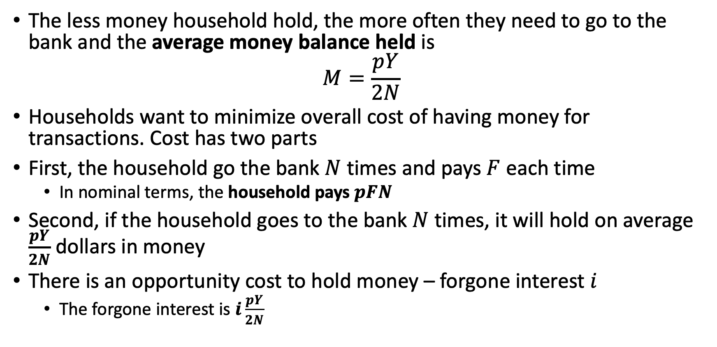
Money Demand
The less money household hold, the more often they need to go to the bank and the average money balance held is
$$M=\frac{pY}{2N}$$
Households want to minimize overall cost of having money for transactions. Cost has two parts
First, the household go the bank $N$ times and pays $F$ each time
In nominal terms, the household pays $pFN$
Second, if the household goes to the bank $N$ times, it will hold on average $\frac{pY}{2N}$ dollars in money
There is an opportunity cost to hold money – forgone interest $i$
The forgone interest is $i\frac{pY}{2N}$

Slide 38
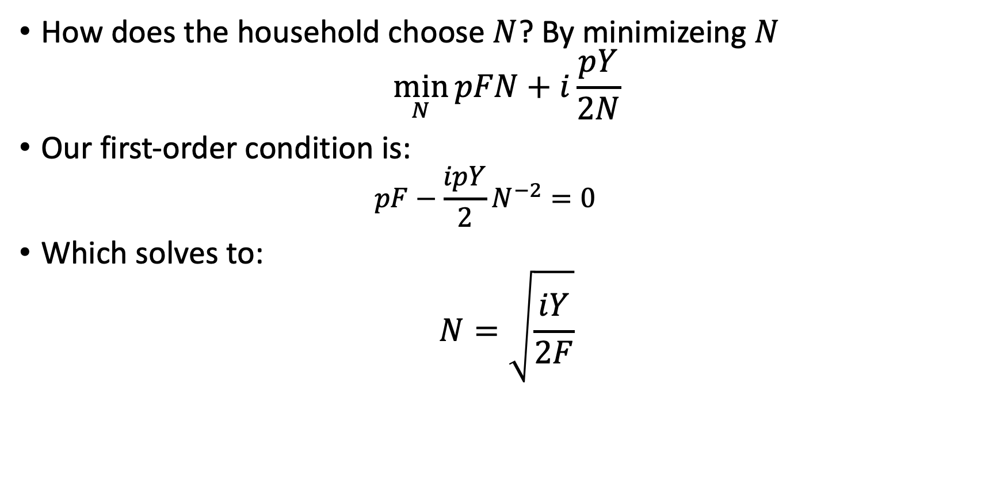
Money Demand
How does the household choose $N$? By minimizeing $N$
$$\min_{N}{pFN+i\frac{pY}{2N}}$$
Our first-order condition is:
$$pF−\frac{ipY}{2}N^{−2}=0$$
Which solves to:
$$N=\sqrt{\frac{iY}{2F}}$$

Slide 39
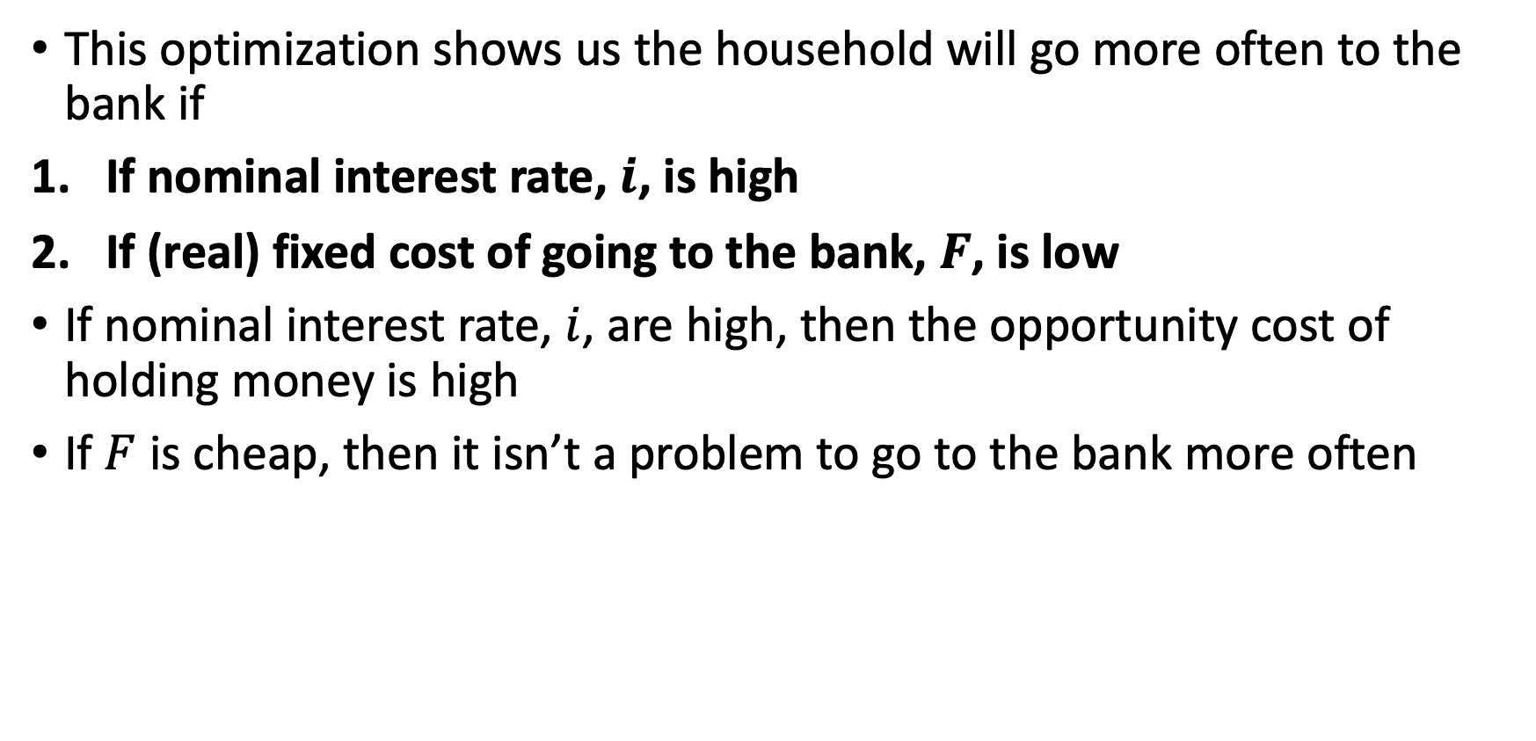
Money Demand
This optimization shows us the household will go more often to the bank if
If nominal interest rate, $i$, is high
If (real) fixed cost of going to the bank, $F$, is low
If nominal interest rate, $i$, are high, then the opportunity cost of holding money is high
If $F$ is cheap, then it isn’t a problem to go to the bank more often

Slide 40
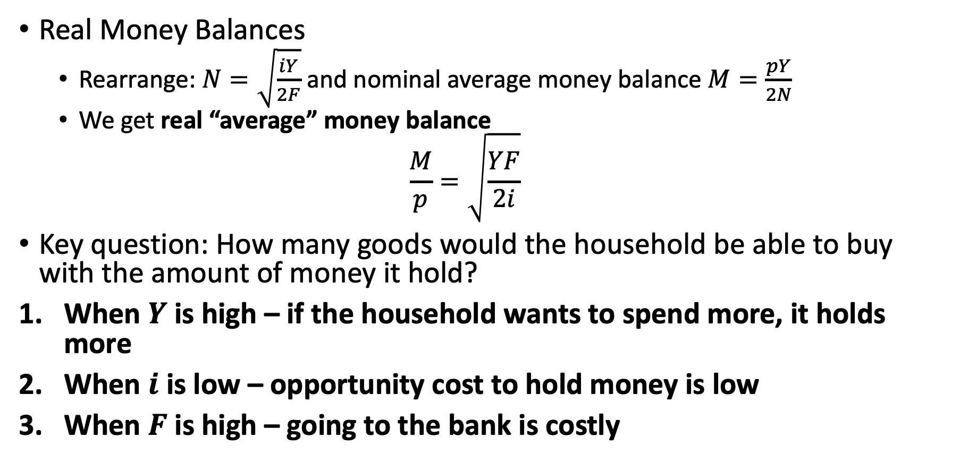
Money Demand
Real Money Balances
Rearrange: $N=\sqrt{\frac{iY}{2F}}$ and nominal average money balance $M=\frac{pY}{2N}$
We get real “average” money balance
$$\frac{M}{p}=\sqrt{\frac{YF}{2i}}$$
Key question: How many goods would the household be able to buy with the amount of money it hold?
When $Y$ is high – if the household wants to spend more, it holds more
When $i$ is low – opportunity cost to hold money is low
When $F$ is high – going to the bank is costly

Slide 41
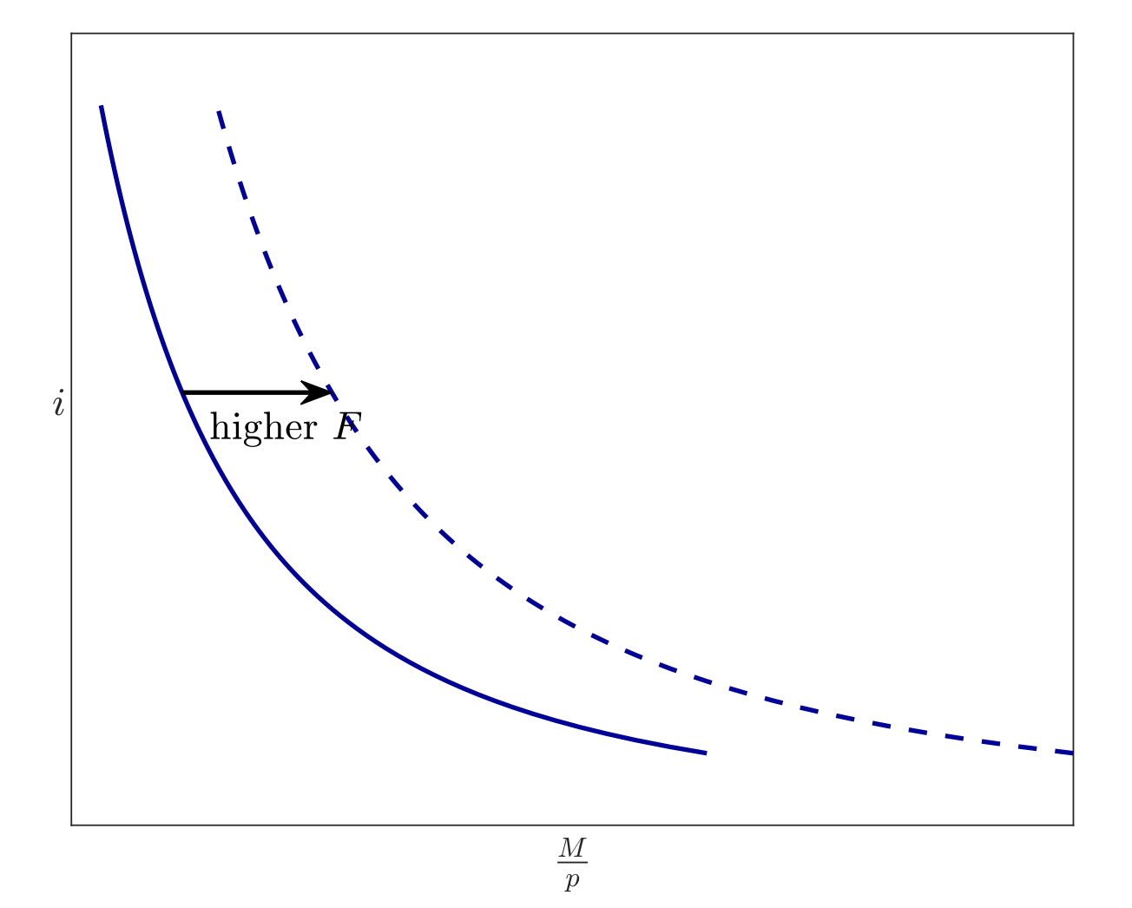
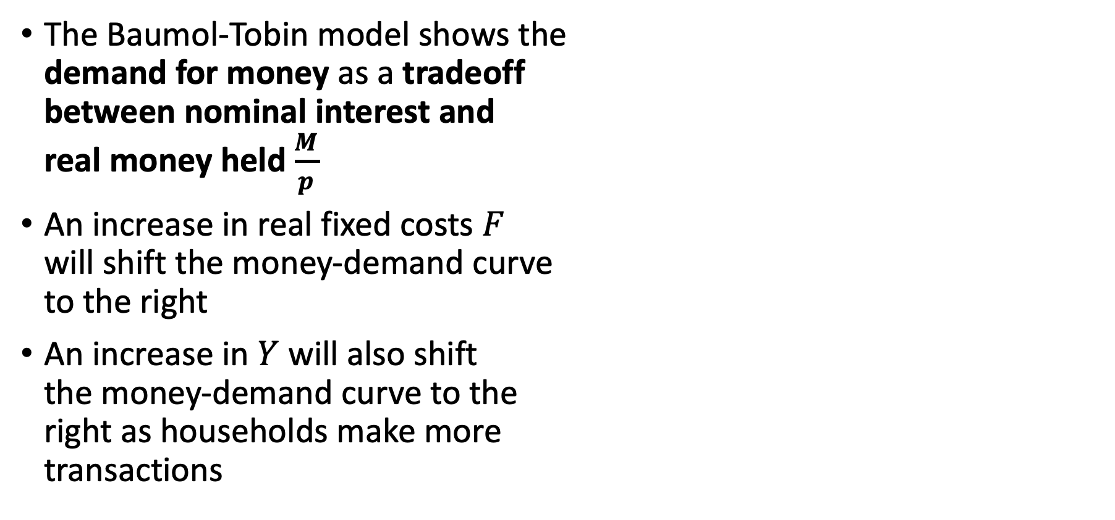
Money Demand
The Baumol-Tobin model shows the demand for money as a tradeoff between nominal interest and real money held $\frac{M}{p}$
An increase in real fixed costs $F$ will shift the money-demand curve to the right
An increase in $Y$ will also shift the money-demand curve to the right as households make more transactions

Slide 42
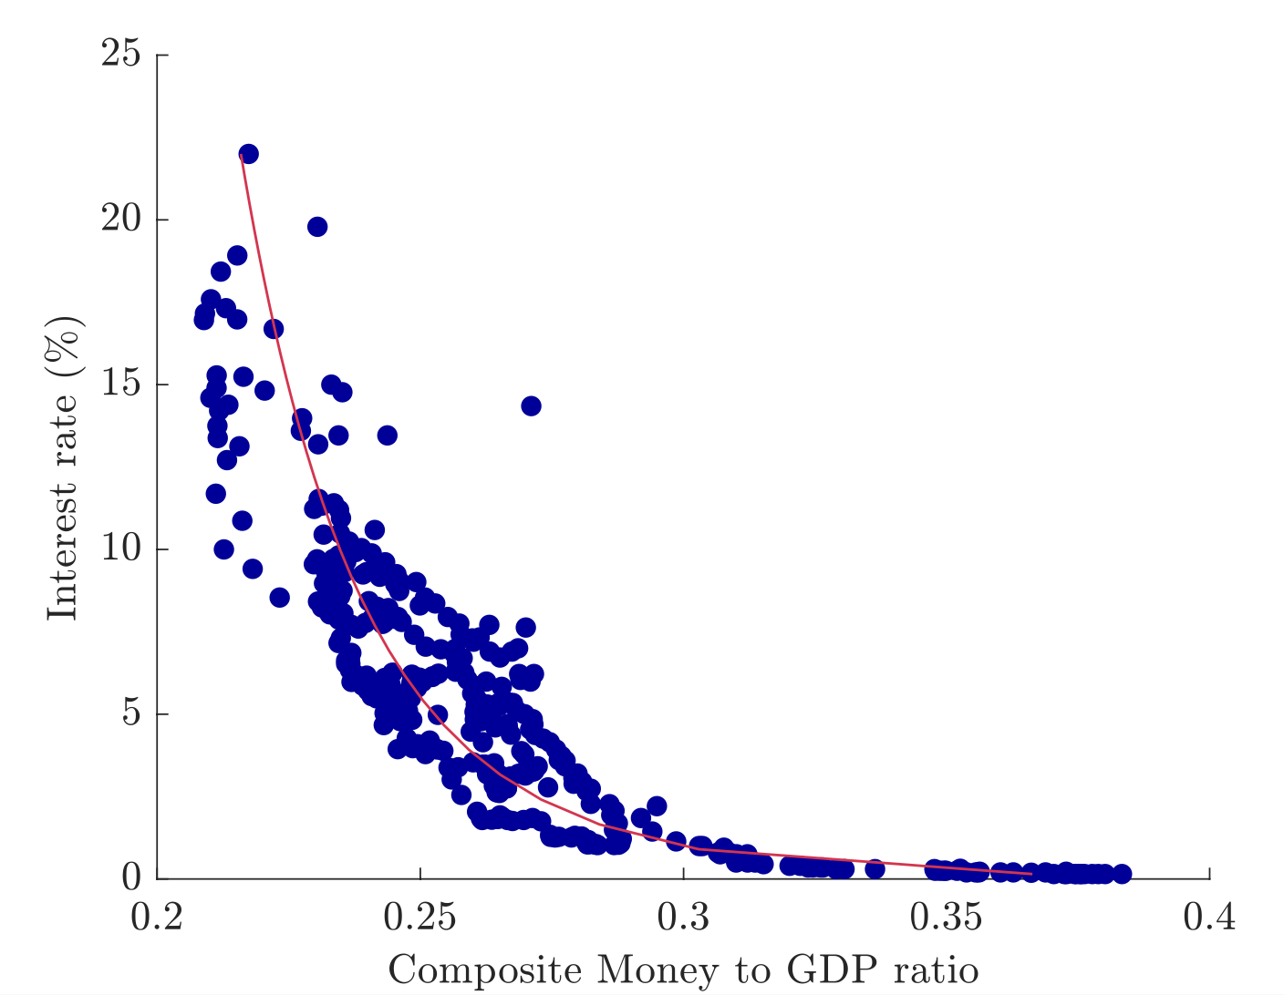
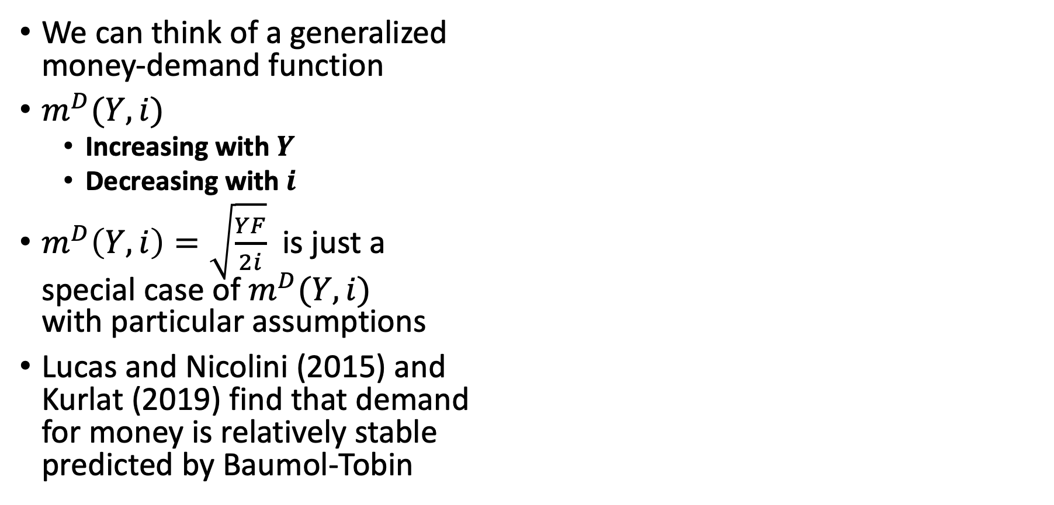
Money Demand
We can think of a generalized money-demand function
$m^{D}(Y,i)$
Increasing with $Y$
Decreasing with $i$
$m^{D}\left(Y,i\right)=\sqrt{\frac{YF}{2i}}$ is just a special case of $m^{D}(Y,i)$ with particular assumptions
Lucas and Nicolini (2015) and Kurlat (2019) find that demand for money is relatively stable predicted by Baumol-Tobin

Slide 43
Price Levels and Inflation
Kurlat Chapter 11

Slide 44
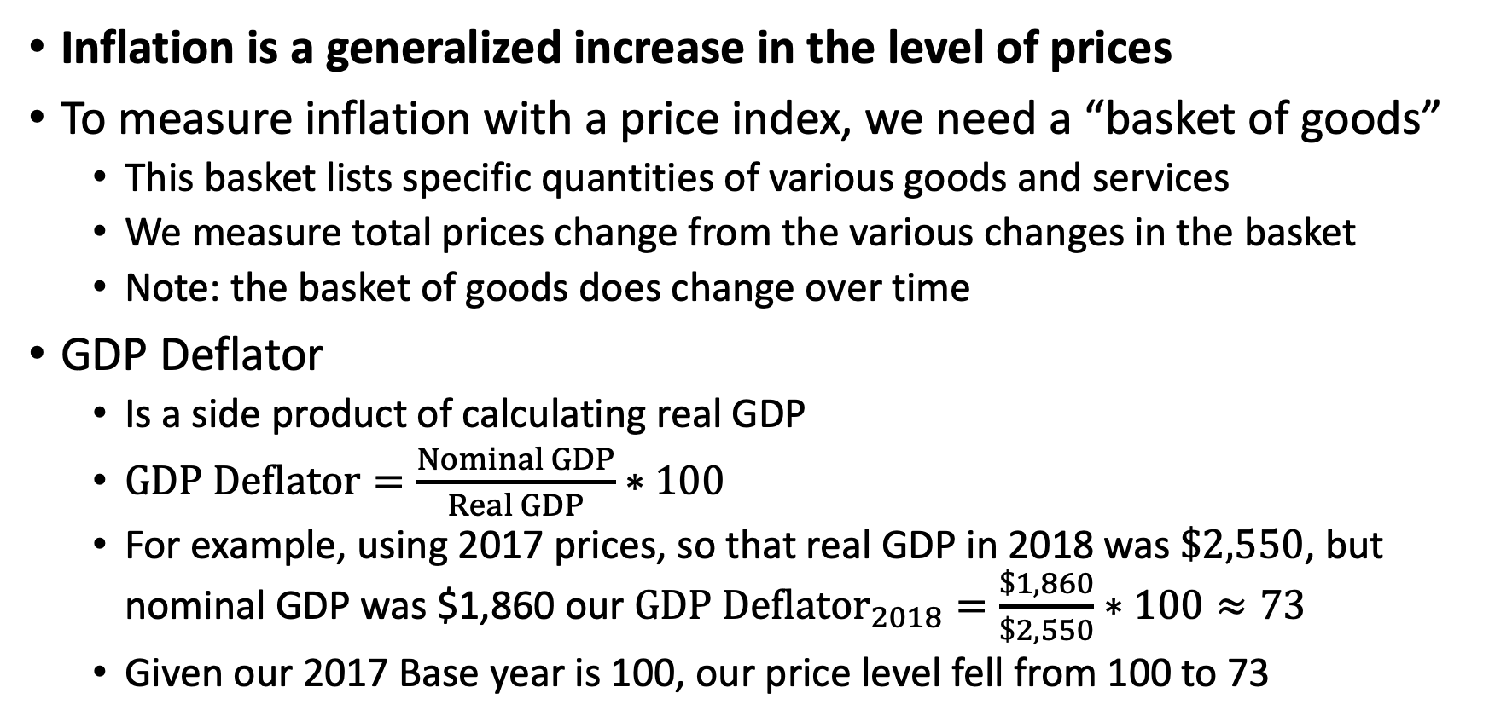
Measurement of Price Levels and Inflation
Inflation is a generalized increase in the level of prices
To measure inflation with a price index, we need a “basket of goods”
This basket lists specific quantities of various goods and services
We measure total prices change from the various changes in the basket
Note: the basket of goods does change over time
GDP Deflator
Is a side product of calculating real GDP
$GDP Deflator=\frac{Nominal GDP}{Real GDP}∗100$
For example, using 2017 prices, so that real GDP in 2018 was $\$2,550$, but nominal GDP was $1,860 our $GDP Deflator_{2018}=\frac{\$1,860}{\$2,550}∗100≈73$
Given our 2017 Base year is 100, our price level fell from 100 to 73

Slide 45
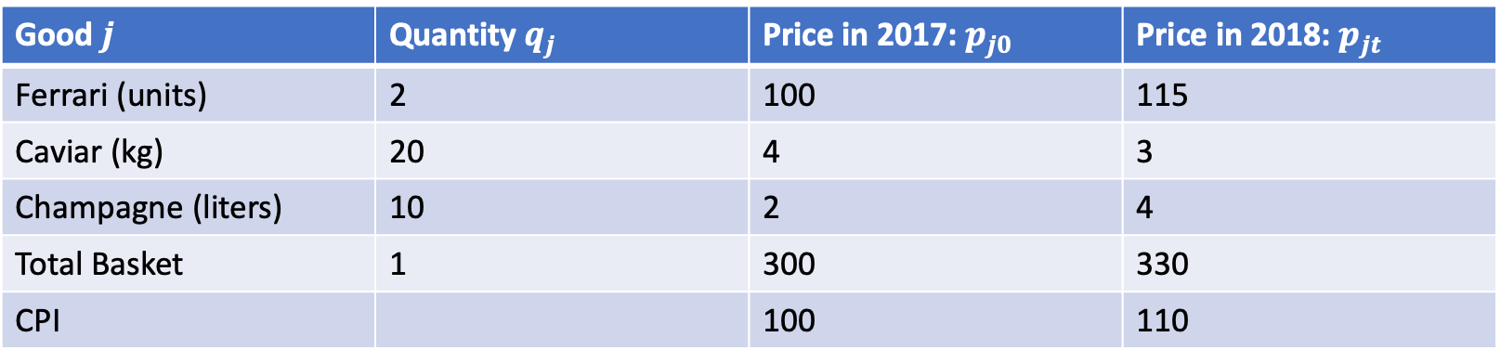
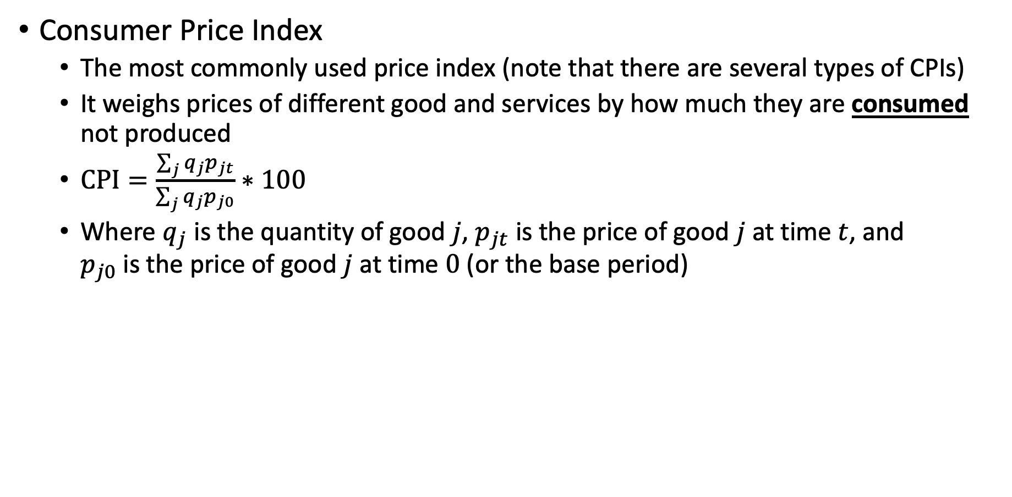
Measurement of Price Levels and Inflation
Consumer Price Index
The most commonly used price index (note that there are several types of CPIs)
It weighs prices of different good and services by how much they are consumed not produced
$CPI=\frac{\sum_{j}{q_{j}p_{jt}}}{\sum_{j}{q_{j}p_{j0}}}∗100$
Where $q_{j}$ is the quantity of good $j$, $p_{jt}$ is the price of good $j$ at time $t$, and $p_{j0}$ is the price of good $j$ at time $0$ (or the base period)
Good $j$ | Quantity $q_{j}$ | Price in 2017: $p_{j0}$ | Price in 2018: $p_{jt}$
Ferrari (units) | 2 | 100 | 115
Caviar (kg) | 20 | 4 | 3
Champagne (liters) | 10 | 2 | 4
Total Basket | 1 | 300 | 330
CPI |  | 100 | 110
There is a 10% increase in prices

Slide 46
Measurement of Price Levels and Inflation
Producer Price Index
This is an index that measures the average changes over time in selling prices received by domestic producers of goods
They may differ from consumer prices due to subsidies, sales taxes, excise taxes, or distribution costs
BLS classifies producer price indexes calculated from cooperating companies
PPI are a basket of good used to calculate our GDP Deflator
BLS publishes a family of price indexes
Industry
Commodities
Commodity-based Final Demand-Intermediate Demand System
This regroups commodity indexes into subproduct classes depending on the final product

Slide 47
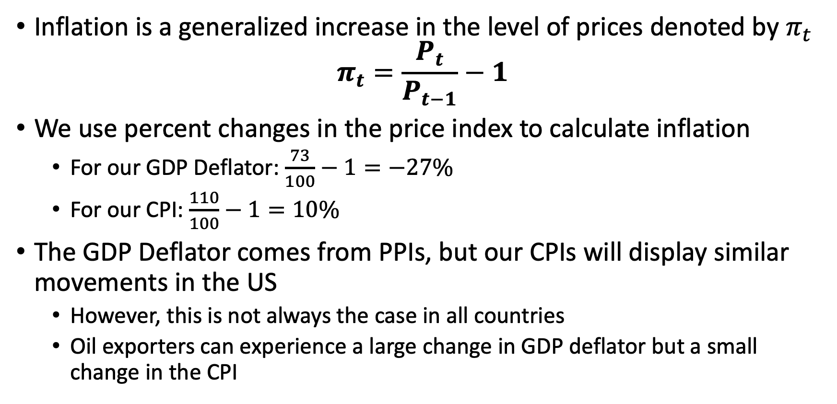
Inflation
Inflation is a generalized increase in the level of prices denoted by $π_{t}$
$$π_{t}=\frac{P_{t}}{P_{t−1}}−1$$
We use percent changes in the price index to calculate inflation
For our GDP Deflator: $\frac{73}{100}−1=−27\%$
For our CPI: $\frac{110}{100}−1=10\%$
The GDP Deflator comes from PPIs, but our CPIs will display similar movements in the US
However, this is not always the case in all countries
Oil exporters can experience a large change in GDP deflator but a small change in the CPI

Slide 48
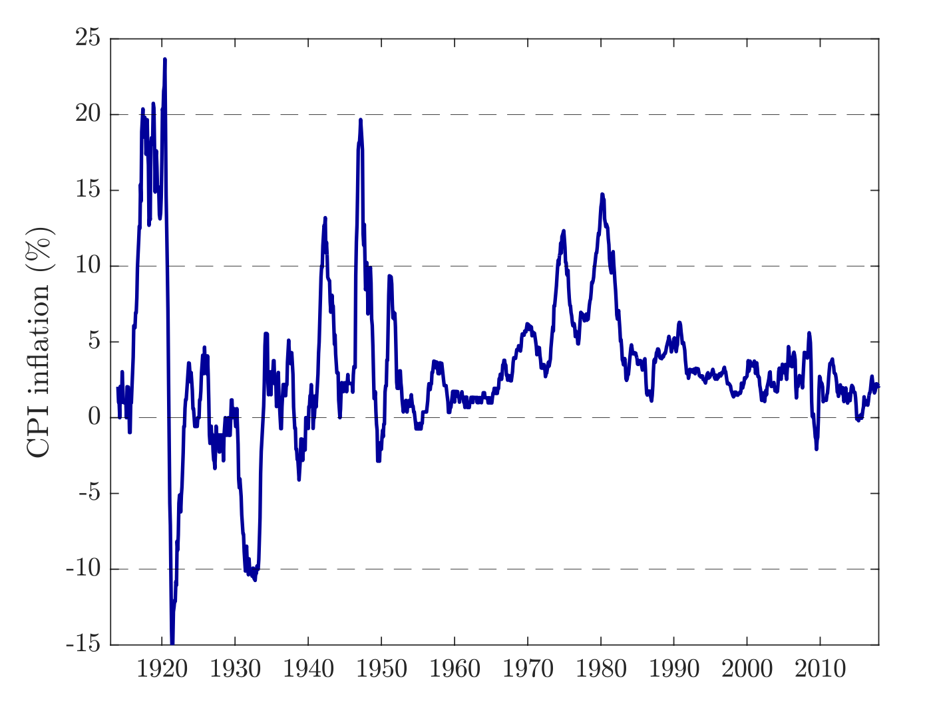
Inflation
Inflation was highly volatile until the 1950s
There was inflationary and deflationary periods during this time
There was general inflation during the 1970s
By the mid-1980s inflation has been low and stable until the Covid-19 pandemic which peaked at 9.1% in June 2022

Slide 49
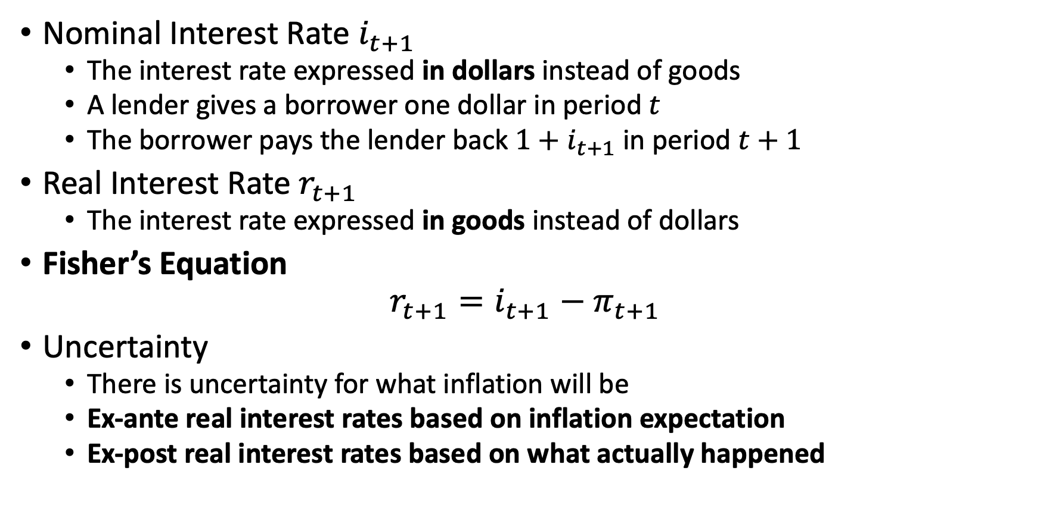
Nominal and Real Interest Rates
Nominal Interest Rate $i_{t+1}$
The interest rate expressed in dollars instead of goods
A lender gives a borrower one dollar in period $t$
The borrower pays the lender back $1+i_{t+1}$ in period $t+1$
Real Interest Rate $r_{t+1}$
The interest rate expressed in goods instead of dollars
Fisher’s Equation
$$r_{t+1}=i_{t+1}−π_{t+1}$$
Uncertainty
There is uncertainty for what inflation will be
Ex-ante real interest rates based on inflation expectation
Ex-post real interest rates based on what actually happened

Slide 50
Equilibrium in the Money Market

Slide 51
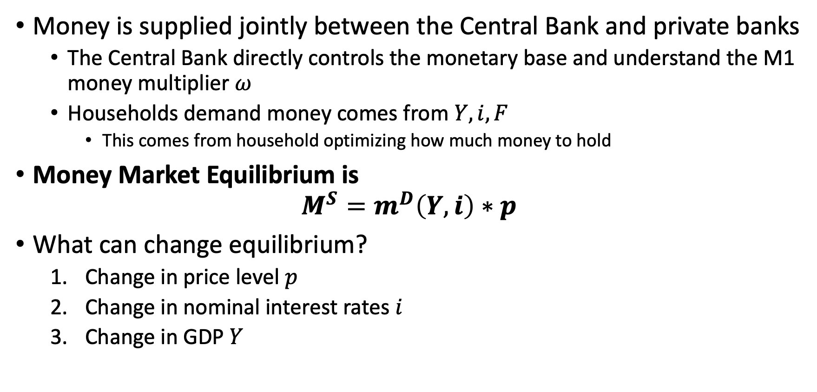
Equilibrium in the Money Market
Money is supplied jointly between the Central Bank and private banks
The Central Bank directly controls the monetary base and understand the M1 money multiplier $ω$
Households demand money comes from $Y,i,F$
This comes from household optimizing how much money to hold
Money Market Equilibrium is
$$M^{S}=m^{D}\left(Y,i\right)∗p$$
What can change equilibrium?
Change in price level $p$
Change in nominal interest rates $i$
Change in GDP $Y$

Slide 52
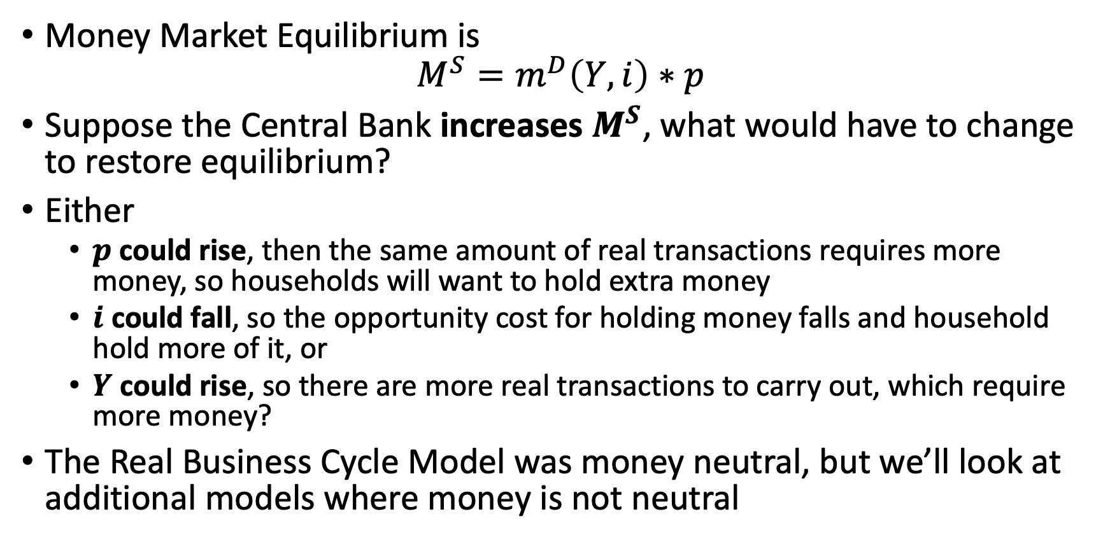
Equilibrium in the Money Market
Money Market Equilibrium is
$$M^{S}=m^{D}\left(Y,i\right)∗p$$
Suppose the Central Bank increases $M^{S}$, what would have to change to restore equilibrium?
Either
$p$ could rise, then the same amount of real transactions requires more money, so households will want to hold extra money
$i$ could fall, so the opportunity cost for holding money falls and household hold more of it, or
$Y$ could rise, so there are more real transactions to carry out, which require more money?
The Real Business Cycle Model was money neutral, but we’ll look at additional models where money is not neutral

Slide 53
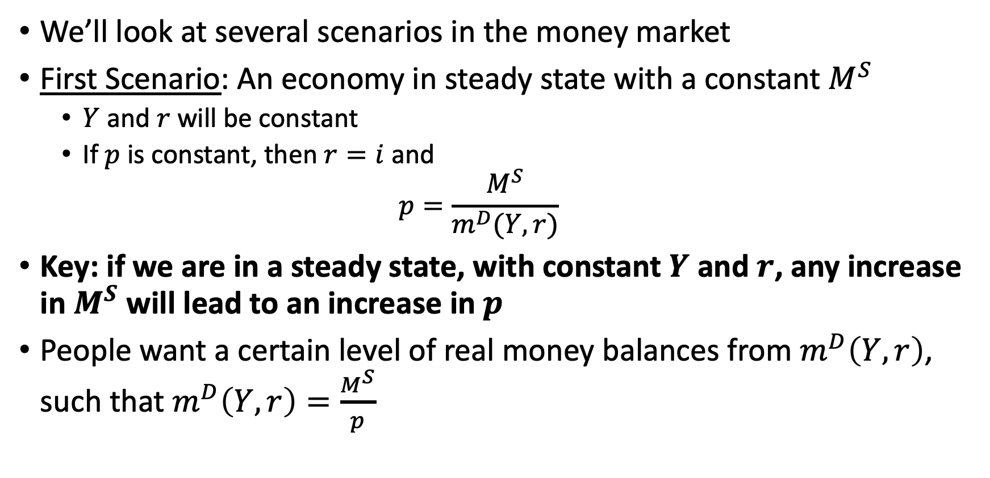
An Economy in Steady State with a Constant Money Supply
We’ll look at several scenarios in the money market
First Scenario: An economy in steady state with a constant $M^{S}$
$Y$ and $r$ will be constant
If $p$ is constant, then $r=i$ and
$$p=\frac{M^{S}}{m^{D}(Y,r)}$$
Key: if we are in a steady state, with constant $Y$ and $r$, any increase in $M^{S}$ will lead to an increase in $p$
People want a certain level of real money balances from $m^{D}\left(Y,r\right)$, such that $m^{D}\left(Y,r\right)=\frac{M^{S}}{p}$

Slide 54
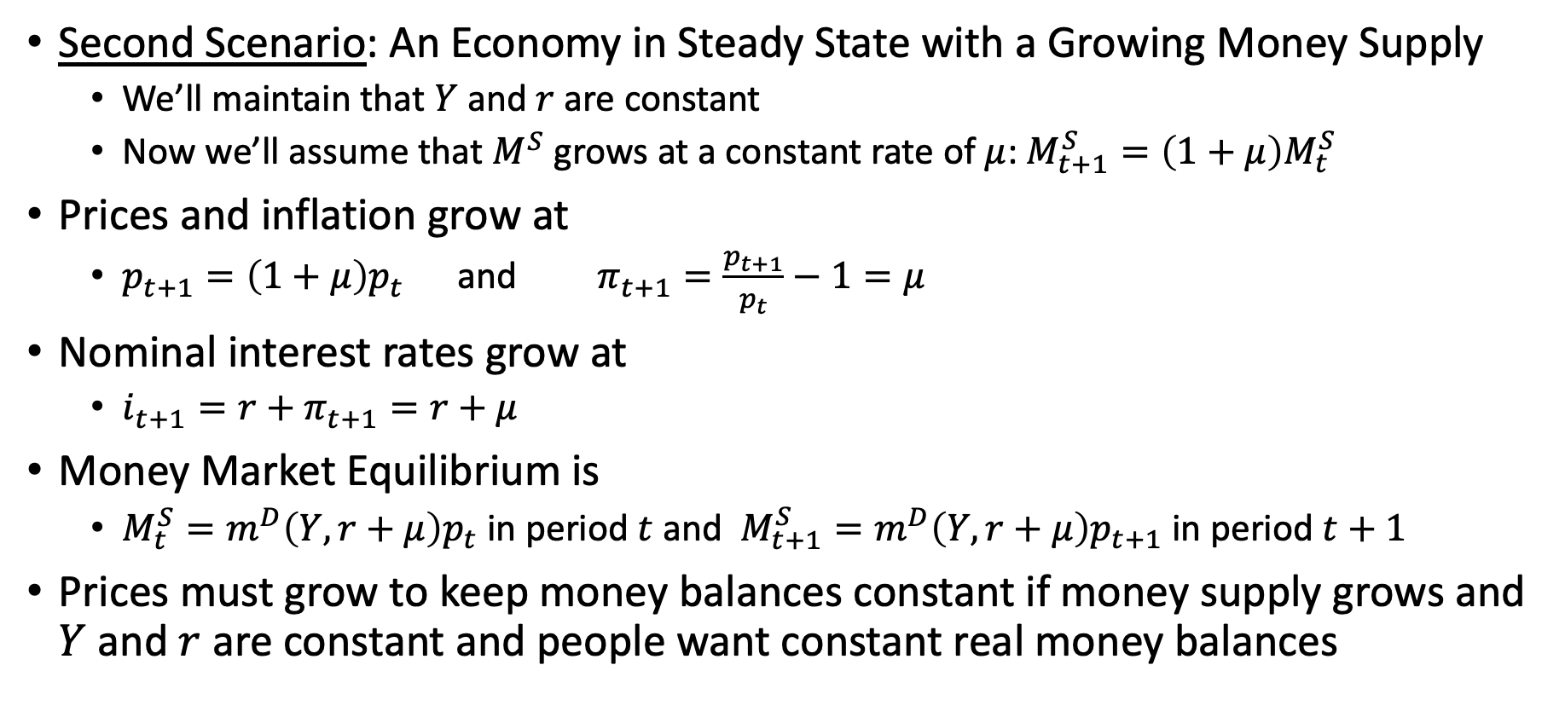
An Economy in Steady State with a Growing Money Supply
Second Scenario: An Economy in Steady State with a Growing Money Supply
We’ll maintain that $Y$ and $r$ are constant
Now we’ll assume that $M^{S}$ grows at a constant rate of $μ$: $M_{t+1}^{S}=\left(1+μ\right)M_{t}^{S}$
Prices and inflation grow at
$p_{t+1}=\left(1+μ\right)p_{t}$ and $π_{t+1}=\frac{p_{t+1}}{p_{t}}−1=μ$
Nominal interest rates grow at
$i_{t+1}=r+π_{t+1}=r+μ$
Money Market Equilibrium is
$M_{t}^{S}=m^{D}\left(Y,r+μ\right)p_{t}$ in period $t$ and $M_{t+1}^{S}=m^{D}\left(Y,r+μ\right)p_{t+1}$ in period $t+1$
Prices must grow to keep money balances constant if money supply grows and $Y$ and $r$ are constant and people want constant real money balances

Slide 55
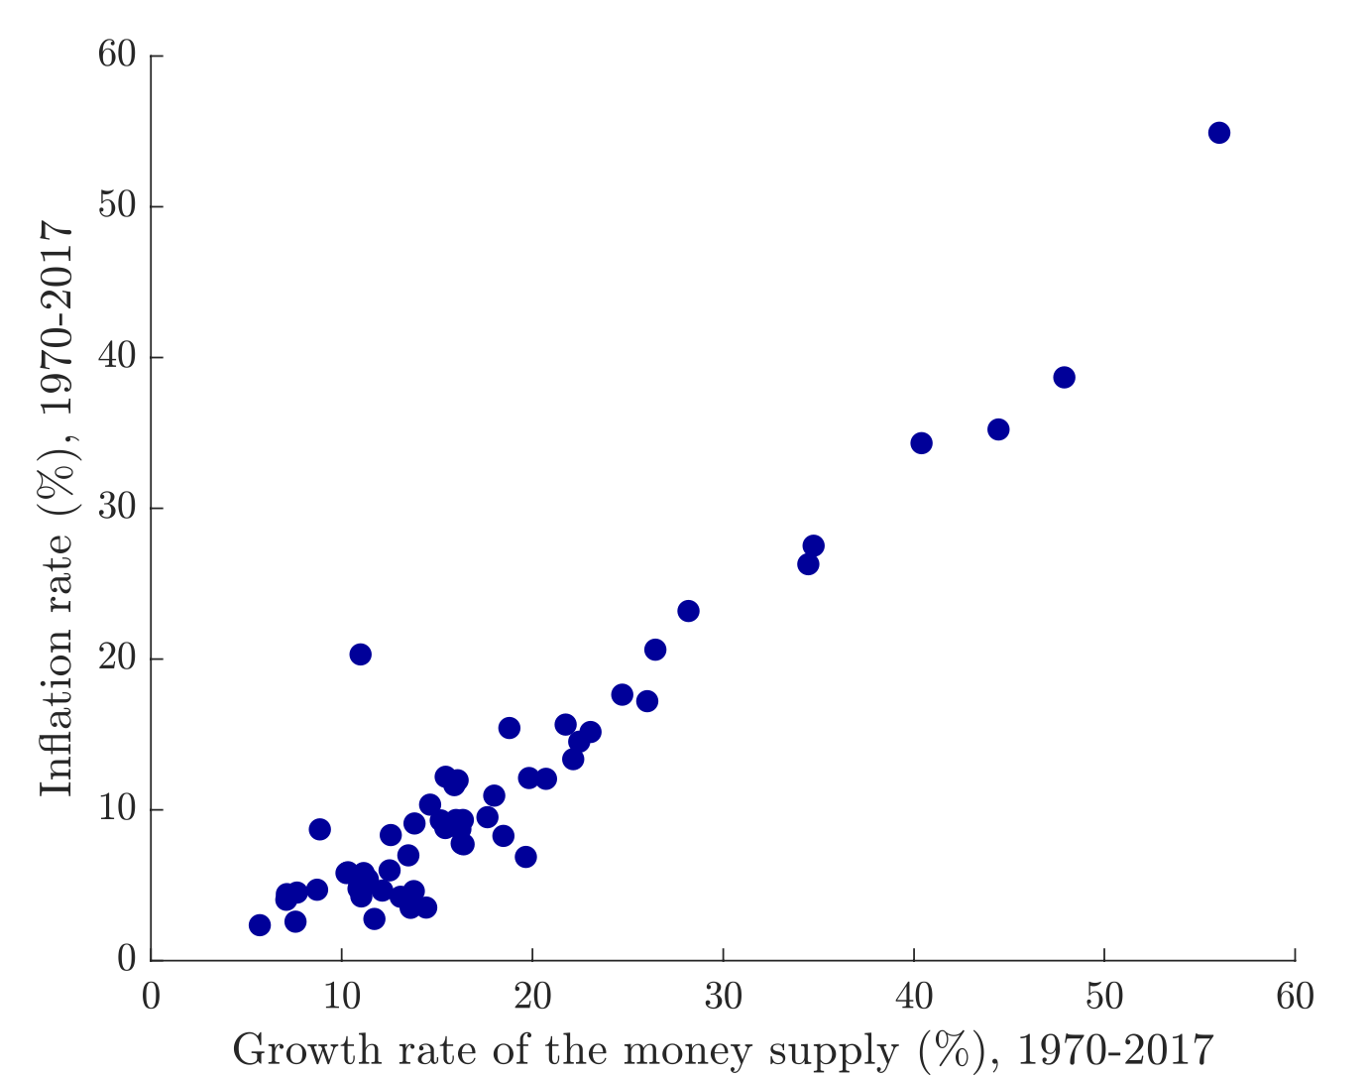
An Economy in Steady State with a Growing Money Supply
Each dot represents a country
It plots the growth of inflation on the y-axis with the growth of money supply between 1970 and 2017
There is a linear association between growth of money supply and inflation
Some countries have low inflation even if their money supply growth was higher

Slide 56
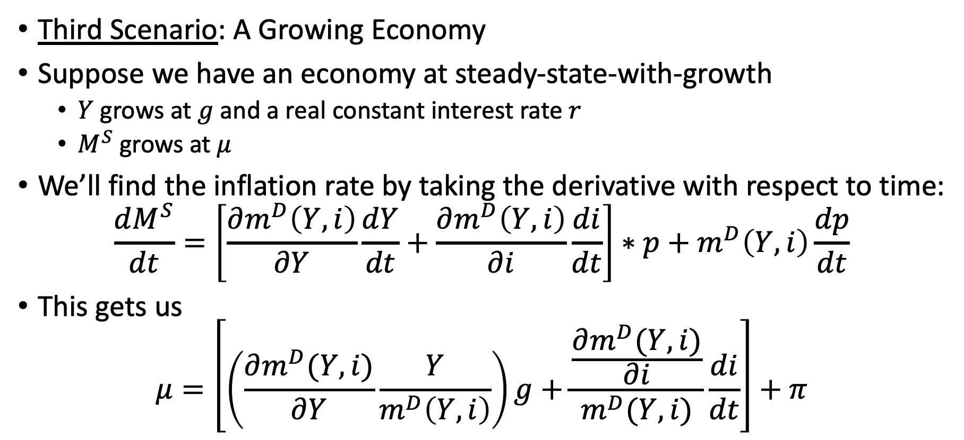
A Growing Economy
Third Scenario: A Growing Economy
Suppose we have an economy at steady-state-with-growth
$Y$ grows at $g$ and a real constant interest rate $r$
$M^{S}$ grows at $μ$
We’ll find the inflation rate by taking the derivative with respect to time: $\frac{dM^{S}}{dt}=\left[\frac{∂m^{D}\left(Y,i\right)}{∂Y}\frac{dY}{dt}+\frac{∂m^{D}\left(Y,i\right)}{∂i}\frac{di}{dt}\right]∗p+m^{D}\left(Y,i\right)\frac{dp}{dt}$
This gets us
$$μ=\left[\left(\frac{∂m^{D}(Y,i)}{∂Y}\frac{Y}{m^{D}\left(Y,i\right)}\right)g+\frac{\frac{∂m^{D}(Y,i)}{∂i}}{m^{D}(Y,i)}\frac{di}{dt}\right]+π$$

Slide 57
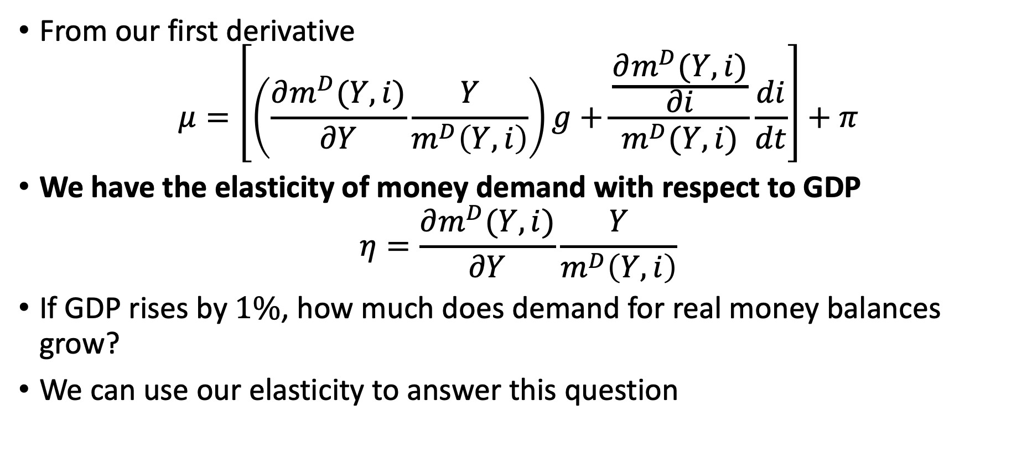
A Growing Economy
From our first derivative
$$μ=\left[\left(\frac{∂m^{D}(Y,i)}{∂Y}\frac{Y}{m^{D}\left(Y,i\right)}\right)g+\frac{\frac{∂m^{D}(Y,i)}{∂i}}{m^{D}(Y,i)}\frac{di}{dt}\right]+π$$
We have the elasticity of money demand with respect to GDP
$$η=\frac{∂m^{D}(Y,i)}{∂Y}\frac{Y}{m^{D}\left(Y,i\right)}$$
If GDP rises by $1\%$, how much does demand for real money balances grow?
We can use our elasticity to answer this question

Slide 58
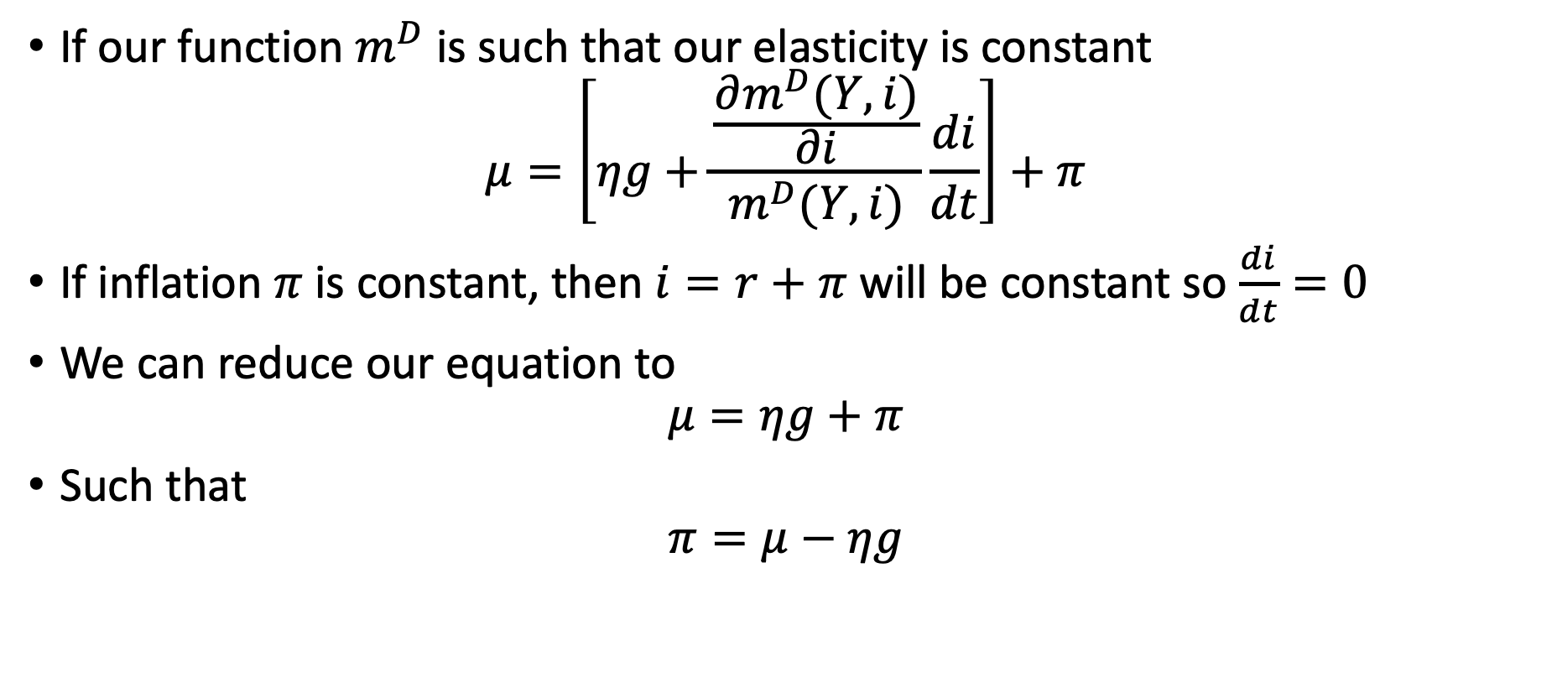
A Growing Economy
If our function $m^{D}$ is such that our elasticity is constant
$$μ=\left[ηg+\frac{\frac{∂m^{D}(Y,i)}{∂i}}{m^{D}(Y,i)}\frac{di}{dt}\right]+π$$
If inflation $π$ is constant, then $i=r+π$ will be constant so $\frac{di}{dt}=0$
We can reduce our equation to
$$μ=ηg+π$$
Such that
$$π=μ−ηg$$

Slide 59
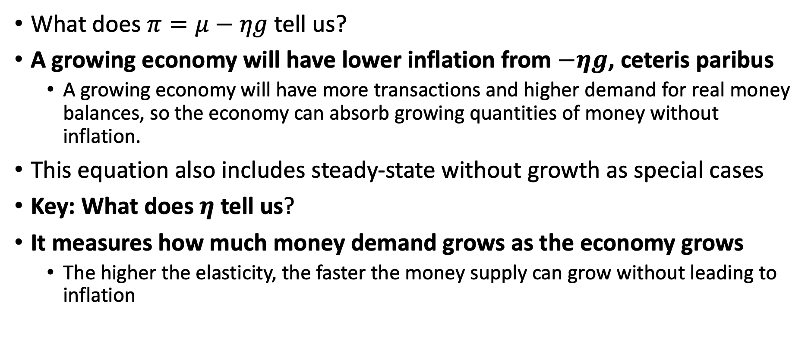
A Growing Economy
What does $π=μ−ηg$ tell us?
A growing economy will have lower inflation from $−ηg$, ceteris paribus
A growing economy will have more transactions and higher demand for real money balances, so the economy can absorb growing quantities of money without inflation.
This equation also includes steady-state without growth as special cases
Key: What does $η$ tell us?
It measures how much money demand grows as the economy grows
The higher the elasticity, the faster the money supply can grow without leading to inflation

Slide 60
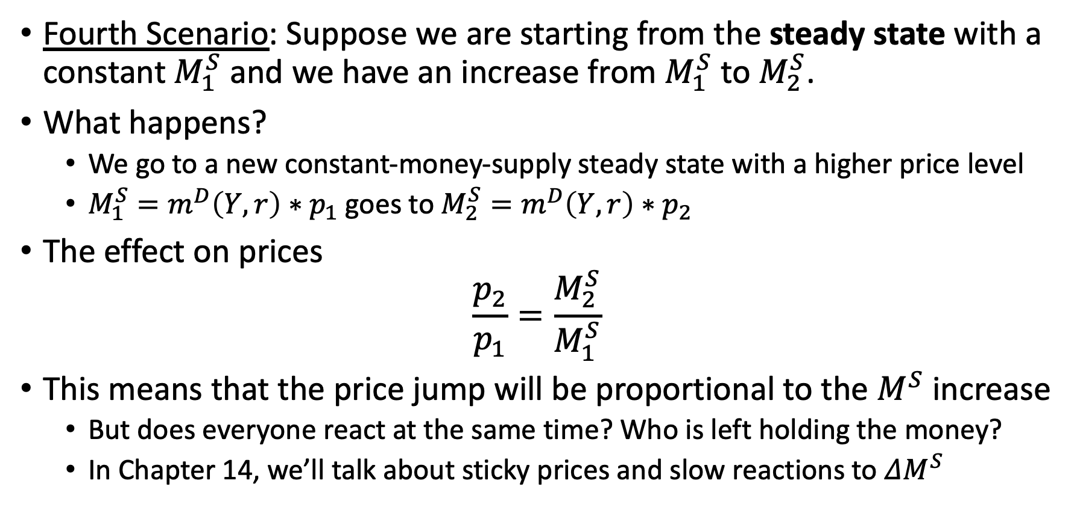
One-Time Increase
Fourth Scenario: Suppose we are starting from the steady state with a constant $M_{1}^{S}$ and we have an increase from $M_{1}^{S}$ to $M_{2}^{S}$.
What happens?
We go to a new constant-money-supply steady state with a higher price level
$M_{1}^{S}=m^{D}\left(Y,r\right)∗p_{1}$ goes to $M_{2}^{S}=m^{D}\left(Y,r\right)∗p_{2}$
The effect on prices
$$\frac{p_{2}}{p_{1}}=\frac{M_{2}^{S}}{M_{1}^{S}}$$
This means that the price jump will be proportional to the $M^{S}$ increase
But does everyone react at the same time? Who is left holding the money?
In Chapter 14, we’ll talk about sticky prices and slow reactions to $ΔM^{S}$

Slide 61
The Velocity of Money
The Velocity of Money
Velocity is the number of times a unit of money is used per period
Example:
Anne produces an apple and sells it to Bob for $1
Bob produces a banana and sells it to Ann for $1
Ann produces asparagus and sells it to Bob for $1
Bob produces a blueberry and sells it to Ann for $1
Ann produces an apricot and sells it to Bob for $1
Bob produces a blackberry and sells it to Ann for $1
In this example,
The money supply is $2 and nominal GDP is $6
Each dollar changes hands 3 times, so the velocity of money is 3

Slide 62
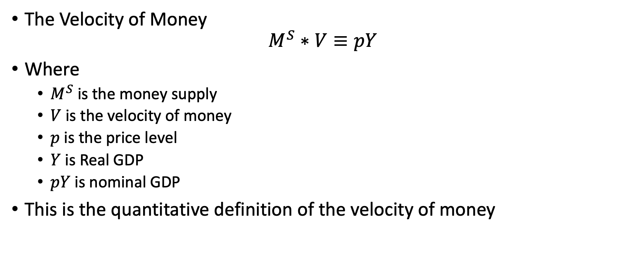
The Velocity of Money
The Velocity of Money
$$M^{S}∗V≡pY$$
Where
$M^{S}$ is the money supply
$V$ is the velocity of money
$p$ is the price level
$Y$ is Real GDP
$pY$ is nominal GDP
This is the quantitative definition of the velocity of money

Slide 63
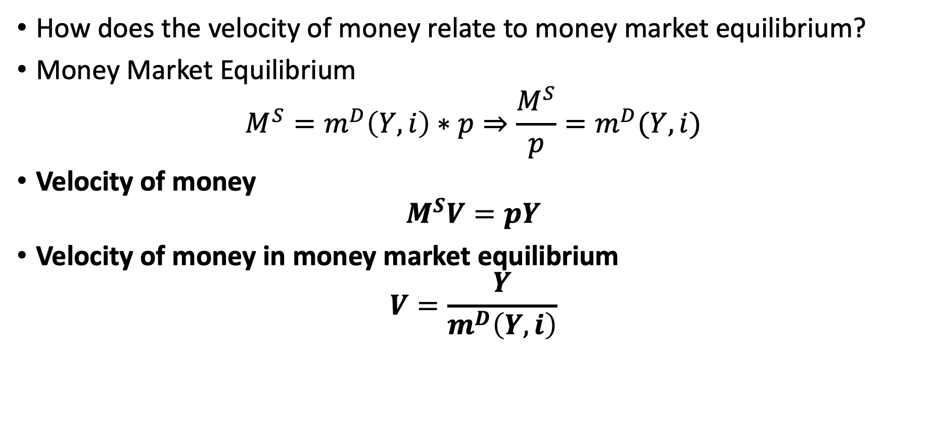
The Velocity of Money
How does the velocity of money relate to money market equilibrium?
Money Market Equilibrium
$$M^{S}=m^{D}\left(Y,i\right)∗p⇒\frac{M^{S}}{p}=m^{D}(Y,i)$$
Velocity of money
$$M^{S}V=pY$$
Velocity of money in money market equilibrium
$$V=\frac{Y}{m^{D}\left(Y,i\right)}$$

Slide 64

The Velocity of Money
Any theory of money demand is also a theory of the velocity of money
If you have a function of $m^{D}(Y,i)$ we can plug it into our equation to find $V$
Velocity of money is an increasing function of $i$
$m^{D}$ is decreasing with $i$, which implies $V$ is increasing with $i$
What does this mean?
The higher the interest rates, the higher the opportunity cost to hold money from money demand
When the opportunity cost to hold money goes up and real transaction remain constant, each dollar has to change hands more frequently
Velocity of money is an increasing function of $Y$
When real transactions go up $(Y goes up)$ and the opportunity cost of holding money stays constant, the velocity has to increase

Slide 65

The Velocity of Money
Quantitative theory: when we assume that $V$ is constant, $MV=pY$ becomes a theory since it says that price level will be proportional to the quantity of money
The velocity of money has evolved over time and has not remained constant in the US
However, this theory can provide insight for countries with large $ΔM^{S}$ and inflation

Slide 66
Seignorage
Seignorage
The profit from the Central Bank obtains from the ability to produce notes and coins
It refers to the resources obtained from the ability to create money
Historically
The value of the coins was more than the precious metal that was used to produce the coins
Profit earned by the mint by turning metal into money was known as seignorage
We’ll see that seignorage is referred to as an inflation tax

Slide 67

Seignorage
The Central Bank gains seignorage through interest
When the Central Bank increases the monetary base by $Δ$, it creates both its assets and its liabilities
It buys the security, which is now an asset on the Central Bank’s balance sheet
However, the bank deposit increases the reserve’s on the liability side
Interest earned
The security asset held by the Central Bank earns interest
The liabilities (reserves and currency) it issues does not earn interest
In essence,
While the Federal Reserve is an independent agency, it is a part of the government
Increasing the monetary base is a way from the government to get a loan it doesn’t have to repay and doesn’t pay interest

Slide 68

Seignorage
The government’s budget constraint
$$B_{t+1}+p_{t}τ_{t}+\left[M_{t+1}^{B}−M_{t}^{B}\right]=p_{t}G_{t}+\left(1+i_{t}\right)B_{t}$$
Where
$B_{t+1}$ is nominal public debt
$G_{t}$ is real government spending
$τ_{t}$ is real government tax revenue (not the rate we have seen before)
$p_{t}$ is the price level
$i_{t}$ is the nominal interest rate
$M_{t}^{B}$ is the monetary base

Slide 69

Seignorage
The government’s budget constraint
$$B_{t+1}+p_{t}τ_{t}+\left[M_{t+1}^{B}−M_{t}^{B}\right]=p_{t}G_{t}+\left(1+i_{t}\right)B_{t}$$
The right hand side is nominal payments the government must pay
$p_{t}G_{t}$ is nominal expenditures to run government functions
$\left(1+i_{t}\right)B_{t}$ is the nominal interest on existing debt at the start of the period
The left hand side is all resources it can use to pay the expenditures
$M_{t+1}^{B}−M_{t}^{B}$ is the change in the monetary base
$p_{t}τ_{t}$ is the nominal tax revenue (where $τ$ is all tax revenue and not a tax rate)
$B_{t+1}$ is the amount of payments from ability of issuing debt to be repaid

Slide 70

Seignorage
Rearranged government constraint
$$M_{t+1}^{B}+B_{t+1}=p_{t}\left[G_{t}−τ_{t}\right]+\left(1+i_{t}\right)B_{t}+M_{t}^{S}$$
We can see that the monetary base is similar to debt in the government budget constraint
However, until issuing debt, the government does not have to pay interest on the monetary base
Why would a government use seignorage to pay for expenditures?
Difficulties in collecting taxes
Wartimes to raise revenue
A lack of ability to issue debt due to lack of trust

Slide 71

Seignorage
What happens when the government uses seignorage to pay for government expenditures?
Anyone who holds money, similar to a tax
Seignorage is called an inflation tax
An expansion of the monetary supply leads to an increased price level
Anyone who holds the monetary base while it’s losing value is giving up wealth to the government
Governments prefer low levels of inflation so they usually limit using seignorage
Seignorage can shrink the tax base
Using too much can lead to high inflation which leads to high $i$
High $i$ leads to falling demand for money

Slide 72

The Cost of Inflation
Increasing the monetary base can lead to inflation, and seignorage from $ΔM^{B}$ can lead to an inflation tax
Inflation is fairly undesirable, but here are some costs
More trips to the bank
“Menu” Costs
Creates uncertainty with prices

Slide 73

The Cost of Inflation
More Trips to the Bank
From the Baumol-Tobin Model, inflation impacts money demand
People will go to the bank more often to avoid holding high money balances
$$Costs=NF=\sqrt{\frac{iYF}{2}}=\sqrt{\frac{\left(r+π\right)YF}{2}}$$
Menu Costs
We need resources to change the display of prices when prices change
Printing new menus, associates changing price tags, creating new signs, etc.
Uncertainty
Consumers need to keep try of how much a dollar is worth making consumption decisions harder
Producers face similar problems by not knowing the price to charge

